Slide 1
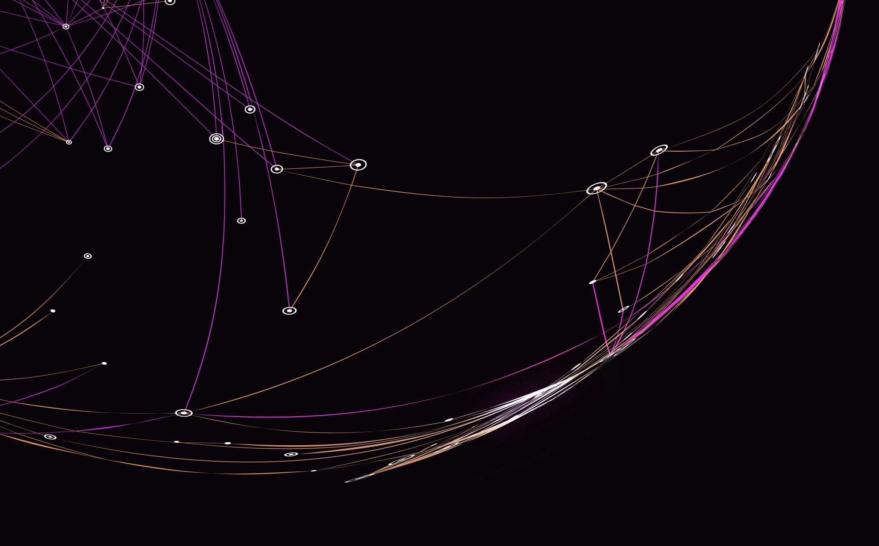
Displacement, Solidarity, Counter-Government
David Owen

Slide 2
Structure of the Argument
Reflection on the general concept of solidarity in order to clarify the kind of relationship and practices which will be the focus of the argument.
Description of the governmental context that shapes the contemporary emergence of displacement as a distinctive form of life characterized by uncertainty, exposure to political violence and racialized border regimes, ongoing iterations of mobility and immobility, and the refusal to be bound by this governmental order. An important part of this discussion is to illustrate that the general class ‘migrants’ is a hierarchically ordered class in which displacement as form of life is produced as the joint effect of this hierarchy and the refusal of it.
Back to the issue of solidarity with those precarious migrants; distinguishing between two modalities of solidarity: humanitarian solidarity and counter-governmental solidarity, before reflecting on their distinct relationships to displacement as contemporary form of life.

Slide 3
The Concept of Solidarity
1. Solidarity = standing with others who confront adverse conditions, where either these conditions or their likely effects can be changed through agents acting together. Formally:
  the concept of solidarity refers to the assuming of associative responsibilities towards others relative to a perceived condition of vulnerability, where these responsibilities entail acting together to protect those in this condition from the harmful effects of their vulnerability and/or transform the conditions that generate the vulnerability in order to reduce or overcome their exposure to this condition of vulnerability.
NB. This encompasses vulnerability to both social and natural forms of power.
2. Two general modes of solidarity: ‘solidarity-with’ and ‘solidarity-between’

Slide 4
Contemporary Migration Governance
(Global North)
Hierarchically ordered via three general types of relations to migrants adopted by the globally advantaged states:
• The desirable. Those who are capital-rich in being seen as possessing highly valued skills or wealth.
• The tolerated. Those who are capital-poor but whose admission is seen as necessary or obligatory for the state.
• The unwanted. Those who are capital-poor and are seen as neither necessary nor obligatory for the state.

Slide 5
The Desired
The Talented (those with talents valued by the state):
  With the rise of the knowledge economy, the premium placed by OECD countries on the skilled migrant’s talent (measured, for example, through post-secondary educational attainment and cutting-edge technological skills) has grown dramatically. It has gained such prominence because “[t]alent is different from other sources of competitive advantage. Talent is encapsulated in individuals . . .” As such, it cannot be codified, duplicated, sold, or easily transferred from one person to another. In other words, it is the human in “human capital” that makes it a unique, distinct, and irreplaceable resource. Add to this the fact that highly skilled workers generate substantial economic value and wealth and it is not surprising that we are now witnessing a growing competition among industrialized nations to attract highly skilled migrants. (2006: 105)
2) The Wealthy (UHNW Individuals)

Slide 6
The Tolerated
“Essential Workers” - while the work performed by these migrants (for example, in care homes) is needed, advantaged states have increasingly raised barriers to permanent residency and citizenship via the use of language and knowledge tests, the lengthening of the time of residence needed to apply for permanent residence, and the scope of good character requirements as well as loosening the conditions enabling removal for the state.
Family Reunion Migrants – “the postwar non-discretionary logic of family immigration, premised on citizens’ right to family life, has become undermined by a competing logic whereby family immigrants are (de)selected on the basis of market-based criteria. In other words, family ties, while necessary, oftentimes are no longer sufficient to gain access to family immigration as states have imposed new conditionalities on family sponsorship ranging from heightened income and age requirements in virtually all states, to policies of civic integration – such as the use of pre-entry language tests – across much of Europe” (Ellerman, 2019: 2521)
Selected (non-spontaneous) Refugees - the major shift has been to attempt to limit access to the state through a range of territorial and extraterritorial measures to those who’s admission, often via the state’s self-determined quota, plays an important symbolic role in sustaining the claim of the state to be a law-respecting international citizen.

Slide 7
The Unwanted
The unwanted denote migrants who are seen as capital-poor and as not playing any valuable role in or for the state. These are migrants for whom, by design, no legal migration pathways into the state are made available and hence require that either entry or continued presence (for example, for those who entered on tourist visas) is irregular in the eyes of the state. This state machinery for the production of irregularity includes so-called ‘spontaneous’ asylum seekers. By systematically limiting safe and legal routes of entry, the policies of advantaged states have both increased the financial burdens on, and the physical dangers to, the vast majority of those seeking asylum in order to deter them from seeking refuge in these states, while engaging in ‘hyperlegalism and obfuscation’ in order to minimize their obligations under international law (Ghezelbash, 2020).

Slide 8
Central Governmental Technique:
The Shifting Border
The unmooring of the border as a legal construct from any fixed territorial marker, that is, the emergence of ‘the shifting border’ (Shachar 2020b, see also Longo 2018) as a technology of governmental power that produces ‘lawless zones’ and ‘rightless subjects’ (Benhabib & Shachar, 2025) as the state’s border is projected out from its territorial boundaries and, simultaneously, bleeds into its interior.
People on the move ‘nowadays routinely encounter the shifting border even before they have left their country of origin, and then again along the travel continuum as they pass through buffer zones, rings of protection, and transit countries’ (Benhabib & Shachar 2025).
The flipside of the shifting border, its invasion of the interior of the state’s territory, works by reducing legal protections for people in certain parts of the state with respect to immigration controls - "constitution-lite" zones - and reducing the legal and political accountability of the border agents in carrying out these practices of surveillance and control.

Slide 9
The Emergence of Displacement as a Form of Life
The production of the category of the unwanted in the hierarchical structure of migration governance is important precisely because the practical effect of the production of this subordinate class is that those who refuse to be governed like this are bound to conditions of precarity in which the quest for conditions of life that can be affirmed as liveable requires risking life, liberty and happiness. It is here, in this conjunction of a hierarchical regime of rule and the refusal of some to be governed through this regime, that we find the formation of displacement as a contemporary form of life characterized by uncertainty, exposure to political violence and racialized border regimes, and ongoing iterations of mobility and immobility.

Slide 10
Migration Governance and the Need for Solidarity
The contemporary migration governance of advantaged states with respect to the unwanted is directed at the exploitation of the vulnerability of these migrants through the calculated exacerbation and exploitation of this vulnerability; the production of precariousness through the intensification of the vulnerability of migrants to morally significant costs, up to and including death.
Central to this intensification of the vulnerability of migrants is the production of conditions of rightlessness such that migrants become objects that can be acted on with impunity, that is, without any effective form of accountability tied to fitting sanctions.

Slide 11
Solidarity with Precarious Migrants
Humanitarian v Solidarity Organisations
Humanitarian Solidarity
Humanitarianism Solidarity and Counter-Governmental Solidarity
Protective and Enabling Counter-Governmental Solidarity
Solidarity and Displacement – two relationships

