Slide 1
Together Apart: Syrian/Turkish Relations in the Eastern Mediterranean Eduardo Chemin FEN – Faculty of Arts and Sciences (Cag University, Mersin, Turkey)

Slide 2
About me
Born in Brazil
Bsc, Mphil, PhD – England (University of Exeter)
Assist Prof Sociology – Cag University, Mersin Turkey.
Co-Editor: Methodologies of Forced Migration: Past and Present Amongst Refugees in the Mediterranean (forthcoming). Transactions: Swedish Research Institute of Istanbul (SRII).
More details:
www.eduardochemin@hotmail.com
www.edchemin.com

Slide 3
Current Projects
“Guests and Hosts Relations in the Context of the Syrian Exodus: A Study of Reciprocal Attitudes Among Turkish and Syrian Populations in the Cities of Mersin, Adana and Tarsus” (with Timucin Aktan – Toros University)
“Trauma, Coping and Religion in the context of the Syrian Diaspora” (with Timucin Aktan and Habibe Gökce, Åbo Akademi, Finland and Cag University)
“Identity and belonging in the City: A Case study of Rapid Urbanization and Identity in the city of Mersin, Turkey” (with Timucin Aktan)

Slide 4
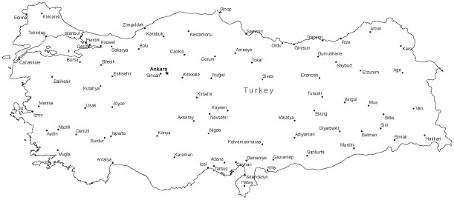


Location
Syria

Slide 5
This Presentation
Turkish/Syrian Relations
Syrian/Syrian Relations
Mersin:
Home or Way Through?

Slide 6
Chemin & Aktan (2016) Study #1 Attitudes and Behaviour of Hosts & Guests (Mersin, Tarsus, Adana)

Slide 7
Study #1
Locations: Mersin, Tarsus, Adana
Sample: 1062 Participants
Period: November 2014 – February 2015
Language used in Interviews: Turkish and Arabic

Slide 8
Gender: 50/50

Slide 9
Mean Age: 30 yrs

Slide 10
Education

Slide 11
Education & Gender

Slide 12
Income Distribution

Slide 13
Summarized Results of Study #1: Turks about Syrians

Slide 14
Syrians are seen as...(-)
1 in every 2 Believe Syrians Should not be in Turkey
Temporary/Transitory Population
Crime Prone
Afraid of Personal Contact
Unreliable/Untrustworthy
Economic and Social Burden
Population is Divided on whether Syrians Should Have the Right to Work or Not
Mersin Residents do not Think they are Culturally Similar to Syrians (Culture/Life-Style)
Syrians Should Learn Turkish

Slide 15
Summarized Results of Study #1: Syrians about Turks and Turkey

Slide 16
Findings: In Turkey Syrians feel... (+)/(-)
Descrimination in the Job Market
Lack of Opportunities for Self Development
Cultural Proximity
Welcomed by Locals: feel accepted
70% welcoming towards hosts (Turkish population)
Feel Gratitude
Satisfied with basic services (who is providing this?)
Not enough assistance from National Government
70% think of going to Europe
76% feel that they are victims of social stigma (but don‘t feel „discriminated“ on an individual level)
Language is a great barrier for integration
Feel uncomfortable when they speak Arabic in public (cultural stigma)

Slide 17
I see that Turkish people like to help/I believe we should help Syrians – comparative responses between the two sample groups

Slide 18
I feel Syrian immigrants are very similar to Turkish people in terms of their culture and way of life – comparative responses between the two sample groups

Slide 19
a) My Syrian identity does not prevent me from finding a job (Syrian sample) b) I would hire Syrians to work for me
(Turkish sample)

Slide 20
Trust, Community & Integration
The Persecution Fear Factor (PFF)
Trust: as a result of Guest/Host relations and PFF. Who is the enemy? Sectarian Conflict/Militias in Syria
Identification: Protection of Friends Immediate Family and Relatives in Syria and the Possibility of Moving to Europe
Community Building and Support Networks becomes Difficult

Slide 21
Global, National & Local Dynamics
Syrians
Trust
1) Between Hosts/Guests
2) Between Syrians Themselves
Politics of Migration (E.U.)
Politics of Migration (Turkey)

Slide 22
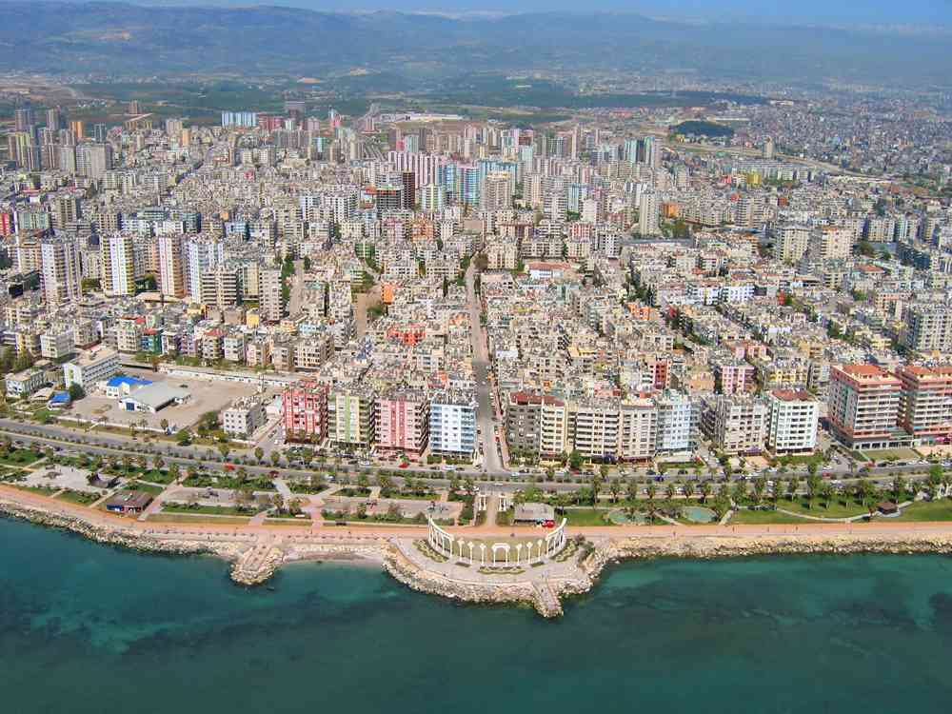
Mersin: A New Home for Syrians or a Way Through?

Slide 24
Population Growth by Districts
2011 2013 P.P.
Akdeniz 274,684 279,383 33%
Mezitli 133,378 158,482 14%
Toroslar 252,706 277,658 30%
Yenişehir 198,912 224,995 23%

Slide 25
Rapid Urbanization: The Case of Mersin (Beyhan et al, 2011)
The period between 1987-2009 :
1) Urban Spread of the built-up areas and the building density at the neighbourhood level.
2) Spatial fragmentation: socially segregated structure of the city
3) Rural-to-urban migration: re-settlement occurring faster than infrastructure development
4) Planned social housing: affect on potential community-development areas
5) Elite Segregation: functional change from a holiday district to a residential area for the middle-classes
6) Privatization: Gated communities and Private schools
7) Tertiarisation of a district by the emergence of shopping and leisure malls/centres.

Slide 26
Mersin: Unsettled Population?
What to do with an unsettled population?
What is the public perception of the native population about the new incomers?
How to make Mersin an inclusive city?
How to make it more prone to community building and truly multi-cultural? (as Syria was before the war!)
How to turn an expense (helping immigrants) into an opportunity to develop (understanding their skills and experience as assets in the re-planning of the city)?

Slide 27
Mersin
Global
Regional
Local
Syrian Crisis

Slide 28
Future (?)
What is the Future for Mersin?
76000 – 400,000?
Population Growth
Unemployment
Infrastructure
Environment

Slide 29
Conclusions
It is clear that the Situation in Syria will Further Deteriorate – More Immigrants coming to Turkey from Syria but also from Neighboring Countries
Trust building Between Locals and „Guests“ and between „Guests“ themselves is paramount in helping people to overcome trauma and acquire a sense of belonging and settled status

Slide 30
Conclusions
More efforts need to be made to avoid ghetoization of Syrians in Mersin by helping change negative attitudes of locals, in particular of local employers
Forced Migrants Should be promoted as a Valuable Addition to Society and not a „Burden“
E.U. / Turkish Politics Creating a very Dangerous Black Market of People Smugglers
Smugglers Benefit from the Collaboration with Local Officials and Local Businessmen (Hotel Owners, Tourism Companies, etc.) as long as International, National and Local policies are not coherent and integrated into an overal plan for refugee settlement

Slide 31
Recommendations
Localities (e.g. The City of Mersin) and civil society via City Partnerships must start independent projects that has a strong practical outcome
Localities (e.g. The City of Mersin) must build a bridge with European, American, Asian and Latin-American authorities via City Partnerships to create a sustainable project where refugees are given a chance to settle permanently in the city (basic language training, schools, universities, professional training that is also open to Tukish locals

Slide 32
Recommendations
A sustainable environmental plan must be put together that will create jobs and opportunities for both migrants but also the host population. There are available funds which can be pursued in Europe, Asia and the United States for the development of , for example, sustainable fisheries, organic agricultural products, eco-villages, self-sustainable learning and living centres

Slide 33
Recommendations
Private Sector must be called into action (e.g. Ülker, Beko, Sabanci, Turkish Airlines, Mersin Port - PSA, Temsa, CAG University, Toros University, IKEA-Sweden etc...)
-web-based assistance for people attending university (U.K. Open University Courses)
-sponsorships
-housing projects
-professionalization programs
-building of open community centres that are inclusive and help Turks and Syrians relate and learn each others customs, traditions and language
-“city membership cards“ (for residents of Mersin – Syrian or Turkish)
-Free Turkish language courses sponsored by the community of language schools in Mersin and universities

Slide 34
THANK YOU!

Slide 35
References
Al Rifai, Diana, Haddad, Mohammed, 2015. What’s Left of Syria? Al-Jazeera News. On-line. March 15th 2015. Available at: http://www.aljazeera.com/indepth/interactive/2015/03 left-syria-150317133753354.html [Accessed 07/05/2015]
Altengi, Maeu, Ghaith Al-Bahr, Abdulrahman Najjar, M. Hani Babelli, Akkash Asheer. 2015. Syrian-Turkish Harmonization – Study on the Syrian-Turkish Harmonization in Gaziantep. SABR & MDN.
Amnesty International, 2015. Syria: Left out in the cold: Syrian refugees abandoned by the international community [on-line]: Amnesty International. Available at: https://www.amnesty.org/en/documents/MDE24/047/2014/en/ [Accessed on 07/05/2015)
Chatty, D. 2015. The Syrian Humanitarian Disaster: Understanding Perceptions, Aspirations and Behaviour in Jordan, Lebanon and Turkey. In: Methodologies of Forced Migration: Past and Present in the Mediterranean [Conference]. Swedish Institute of Research of Istanbul, Istanbul, 27- 29 April: Unpublished.
vailable at http://data.unhcr.org/syrianrefugees/asylum.php Accessed on 17 May 2015.

Slide 36
References
Chemin, E., Aktan, T. Gokce, H. Forthcoming. Methodological Challenges in the Study of Forced Migration: Trauma, Resilience, Religion and Politics in the Context of the Syrian Diaspora in Turkey in Chemin, E. Cedrez Ö., Korkut, U., Chatty, D. Methodologies of Forced Migration: Past and Present among Refugees in the Eastern Mediterranean. Istanbul: Swedish Institute of Research.
CIA, 2015. The World Fact Book. [on-line] Central Intelligence Agency, USA. Available at: https://www.cia.gov/library/publications/the-world-factbook/geos/sy.html [Accessed on 07/05/2015].
Dinçer, O. B., Federici, V., Ferris, E., Karaca, S., Kirişci, K., & Çarmıklı, E. Ö. (2013). Turkey and Syrian Refugees: The Limits of Hospitality. International Strategic Research Organization (USAK).
Güçer, M. Karaca, S. O., Dinçer, B. (2013). The Struggle for Life Between Borders. Syrian Refugees Fieldwork. International Strategic Research Organization (USAK).
Harlak, H. (2000). Önyargılar: Psikokososyal bir inceleme. İstanbul: Sistem Yayıncılık

Slide 37
References
Özden, Senay. 2013. Syrian Refugees in Turkey. Migration Policy Centre. Available at http://cadmus.eui.eu/bitstream/handle/1814/29455/MPC-RR-2013%2005.pdf?sequence=1 Accessed 20 September 2015.
Orhan, Oytun and Sabiha Senyücel Gündoğar. 2015. ‘Effects of the Syrian Refugees on Turkey’. Orsam. Online. Available at http://www.orsam.org.tr/en/enUploads/Article/Files/201518_rapor195ing.pdf Accessed 22 September 2015.
UN 2013. UN Demographic Year Book: Economic and Social Affairs. Online. Available at http://unstats.un.org/unsd/demographic/products/dyb/dybsets/2013.pdf Accessed on 17 May 2015
UNHCR. 2015. Syrian Regional Refugee Response: Inter-Agency Information Sharing Portal. Online. A

