Slide 1
The Syrian Refugee Crisis: Perceptions and Reflections on a Regional Crisis
Refugee Studies Centre, University of Oxford
9 December 2015
Shaden Khallaf
Senior Policy Officer
Policy Unit
MENA Bureau UNHCR

Slide 2
OVERVIEW
Scale and Scope
Protection Environment
Humanitarian Aid Architecture
Urban and protracted nature of displacement
Innovation Imperative
Partnerships and advocacy
  Civil Society Initiative
  Academia and Think Tanks
Refugee Agency and Dignity
Onward movements to Europe
Crisis of Hope

Slide 3
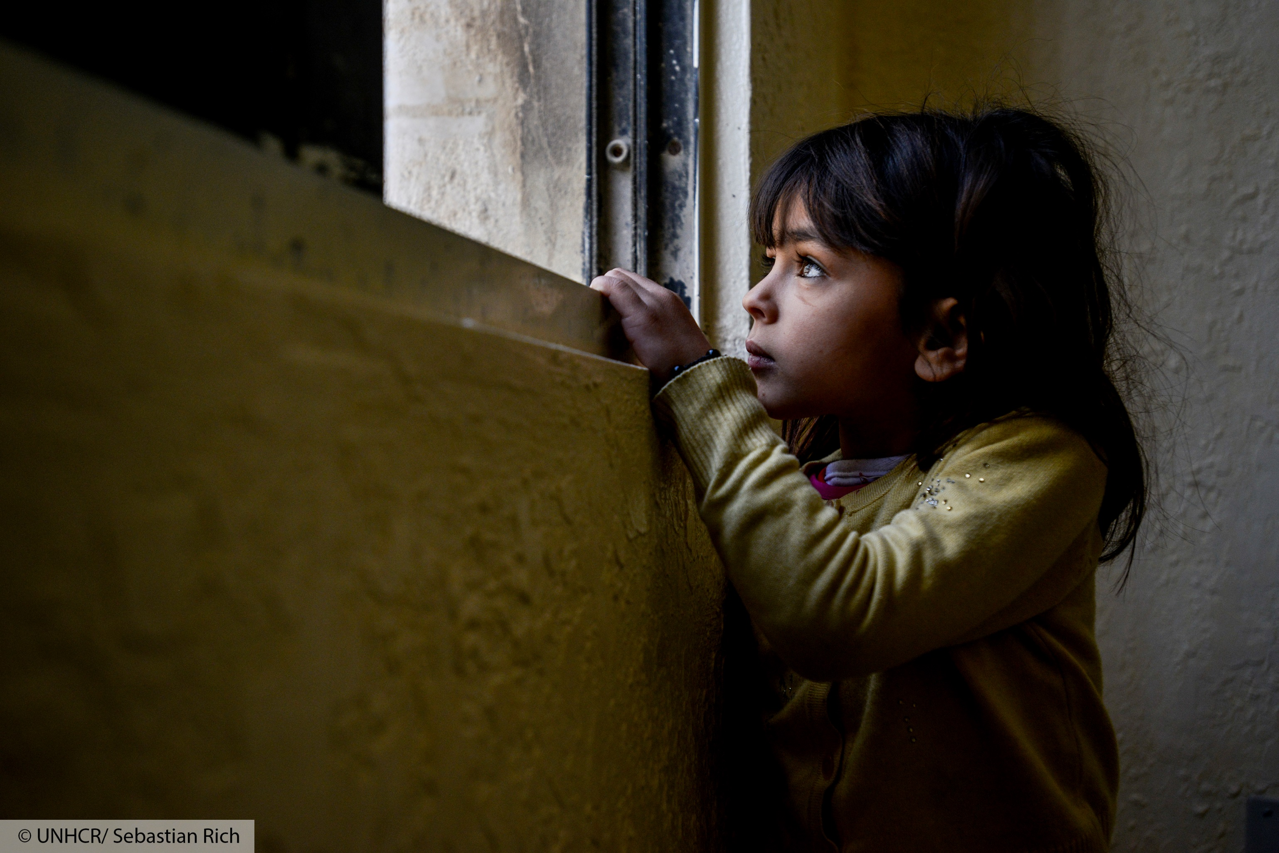
SCALE AND SCOPE OF THE SYRIA REFUGEE CRISIS
Notes:
General Introduction:
Regional Dynamics and context
Consequences of the situation in Syria have a regional dimension: displacement and related fatigue in neighbouring countries and instability, now particularly tangible in Iraq.
In addition, MENA region is facing multiple complex emergencies: Libya and Yemen. Complex and dynamic operations that requires UNHCR rapid response.
The level of internal displacement in Iraq and Syria is unprecedented.
Mid-2014, Syrians became the largest refugee population under UNHCR’s mandate

Slide 4
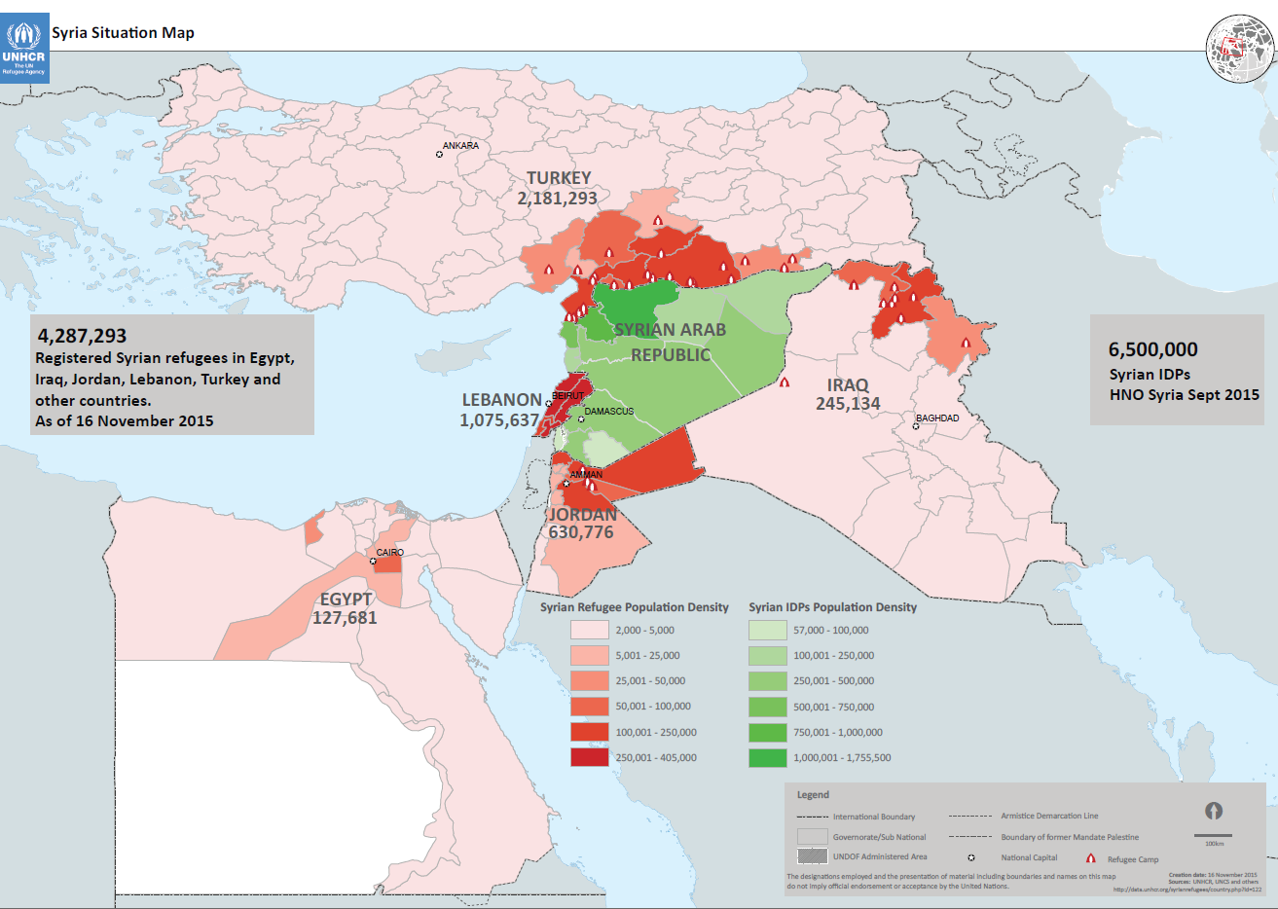
1,758,092
7.6 million Syrian
IDPs
1,196,560
247,861
628,427
133,862
Notes:
Syrians have became the largest refugee population under UNHCR’s mandate with 4.2 million refugees.
Lebanon and Jordan rank first and second in the world in refugees per capita (at least 25 percent of Lebanon’s population; 9.2 percent of Jordan’s).
Around 85 per cent of Syrian refugees in neighboring states live outside camps, in local communities. The longer they’re in exile, the fewer resources they’ve got and the more dependent they become on humanitarian aid.
Refugees: 4,289,994 (Turkey: 2,181,293; Lebanon: 1,078,338; Jordan: 630,776; Iraq: 245,134; Egypt: 127,621; North Africa: 26,772).
Europe figures: 52 per cent of the 792,883 refugees and migrants arriving by sea in 2015 are Syrians.

Slide 5







NEEDS
Protection 142,000 Syrian refugee children born in exile and in need of birth registration
Food 2.58 million Syrians targeted for food assistance.
Education Nearly half of school-age children not enrolled
Core Relief Projected 80,000 new arrivals per month in need of basic domestic items and cash assistance
Health 1 million refugee women and girls of reproductive age and 700,000 refugee pregnant women
Shelter 90% of refugees living outside camps, many in inadequate shelter
WASH 28% of refugees outside camps do not have access to water and 39% do not have access to sanitation
Notes:
Protection – 4.68 million targeted in 2015
Food – Voucher decreased by an average of 13% in five host countries
Education – Nearly 50% of the 950,000 registered school-age Syrian refugee children in refugee hosting countries are not enrolled in school. There have been improvements since the launch of the ‘no lost generation’ initiative. The proportion of out-of-school Syrian refugee children decreased from 70% in 2013 to 52 % in 2014.
Core Relief – 1.56 million targeted in 2015. Enhanced targeting mechanisms will ensure the most vulnerable receive assistance
Health – Increasing demand throughout region is stretching national health systems and services. Management of non-communicable diseases is a significant challenge.
- 1 million refugee women and girls
Shelter – up to 500,000 people will be accommodated in 35 refugee camps in Iraq, Jordan and Turkey in 2015. For those outside of camps, an increasing number are now living in sub-standard shelters, including nearly 300,000 refugees in 1,800 informal settlements in Lebanon and Jordan
WASH – All refugees living in camps require WASH support. Outside of camps, host communities infrastructure is under considerable strain

Slide 6
PROTECTION ENVIRONMENT

Slide 7
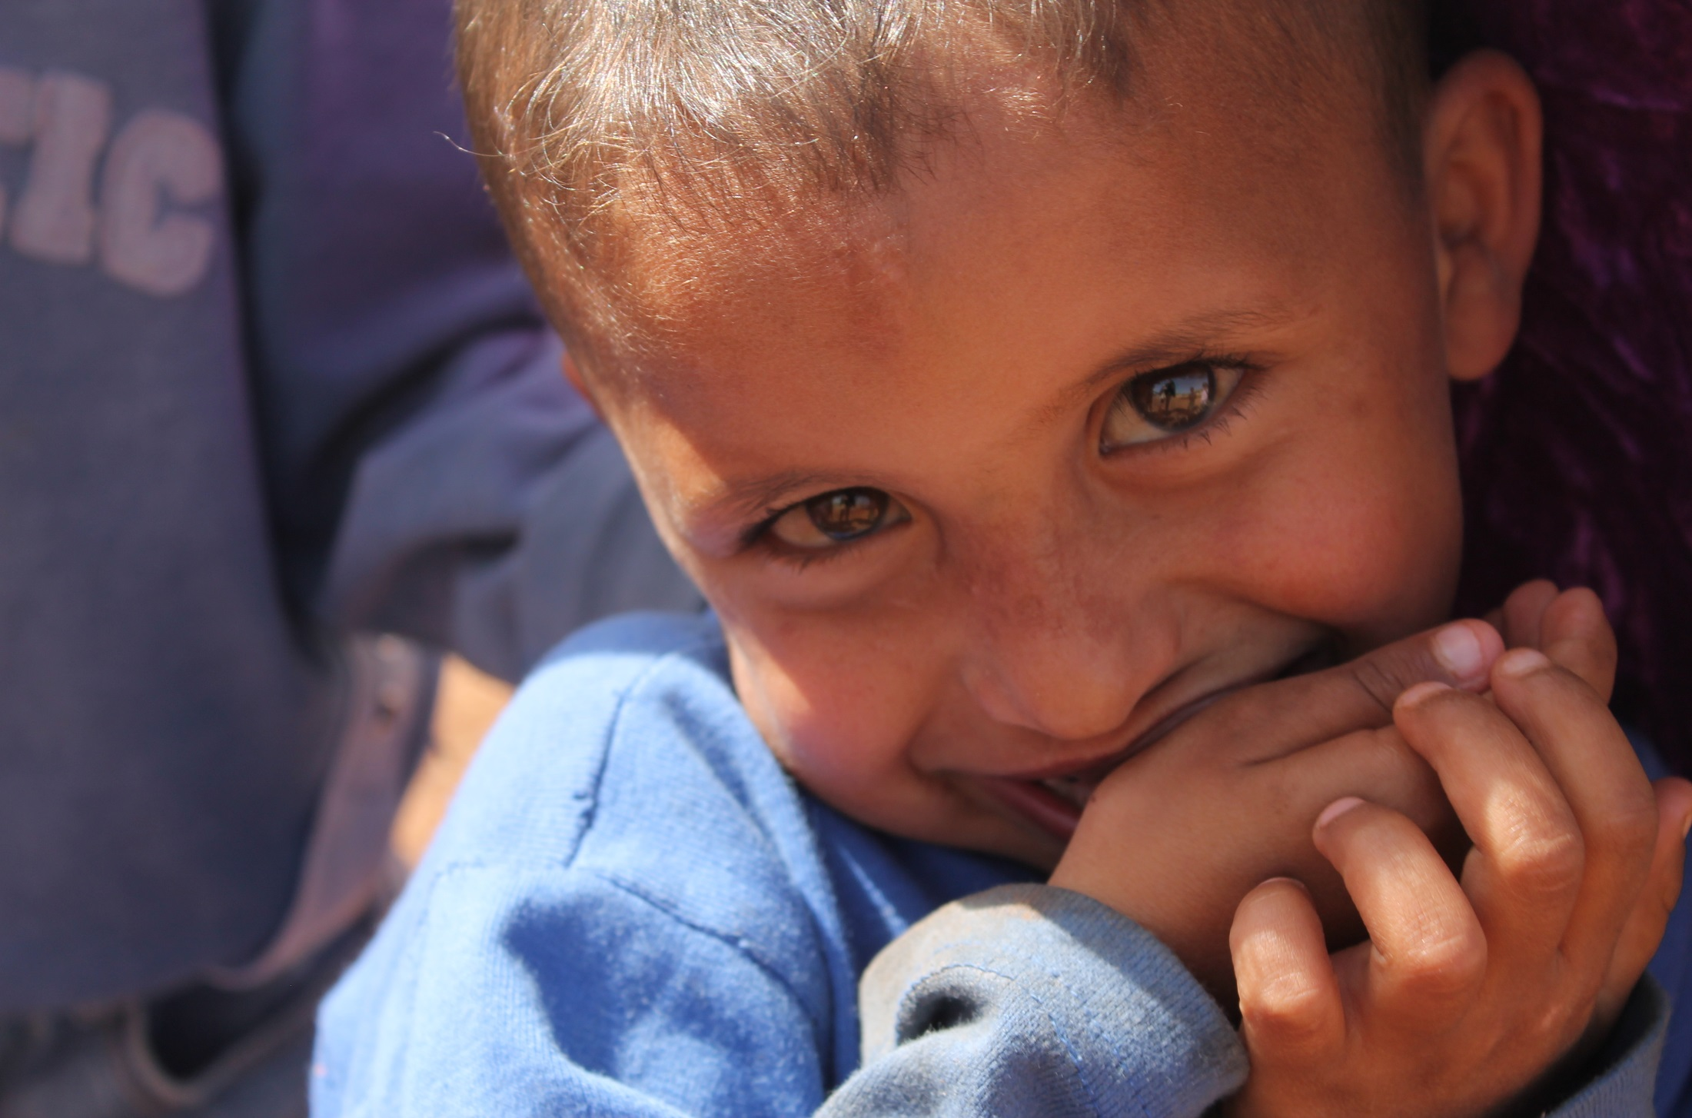
PROTECTION ENVIRONMENT
Shrinking humanitarian space
Monthly registration numbers falling
Increasing security concerns
Unprecedented impact on host countries
Protracted nature of the conflict
Widening gaps between growing needs and financial resources
Notes:
Host Communities
The refugee influx has worsened pre-existing problems and created huge new pressures in host countries, severely overstretching infrastructure and social services; worsening unemployment; negatively affecting economic output and investment; increasing security concerns and generating social tensions between refugees and local host communities.
Countries have been overwhelmed in their capacity to absorb refugees without more international help and resulting in tighter border policies and other restrictions on Syrians.
Protection Environment
Lebanon
According to a regulations implemented on 05 January, Syrians wishing to enter Lebanon will be admitted if for an approved reason upon presentation of valid identity documents and proof of purpose of their sojourn in Lebanon. A list of categories for which admission would be granted was provided, as well as the duration of the authorized stay in Lebanon. Government public announcements also clarified that the measures did not pertain to refugees. Refugees would not be admitted to Lebanon unless for exceptional humanitarian reasons.
Humanitarian criteria envisaged are – at this stage – reported to be limited to: unaccompanied or separated children and persons with disabilities whose relatives are confirmed to be present in Lebanon; persons in need of life-saving medical treatment not usually available in Syria. As of 23 April, the General Security Office is still discussing with MOSA on this issue and welcomes UNHCRs technical support.
Since the implementation by GSO of the new entry regulations during the last quarter of 2014, UNHCR’s registration figures decreased by 50 per cent.
In 2014, the registration monthly average was 41,500/month. Between January and March 2015, monthly registration figures fluctuated between 11,200 – 13,700 Syrian refugees/month
Jordan
Since mid-2013 the Government has limited entry through unofficial crossings to the northeastern border with Syria.
From 1 April, the Jaber/Nasseb border was closed by the Jordanian Government following heavy fighting on the Syrian side. The Ramtha border remains open, however access to Syrians who had been registered previously in Jordan is often denied, including for many vulnerable cases.
UNHCR has registered a drastic drop in the number of Syrians crossing since the end of September 2014.
In 2014, a total of 120,175 were registered, with a monthly average of 12,150/month, which decreased in the last three months of 2014, fluctuating between 3,300 – 4,169/month. In January, 1,892 Syrian refugees were registered but the figures are increasing in 2015: 3,008/month in February and 5,240 in March 2015.
UNHCR negotiated with the Government to extend the validity of UNHCR issued certificates from 6 to 12 months.
There is a continuing trend of higher numbers of refugees returning to Syria as compared with those entering the country. In the first 9 days of February, 307 individuals returned across the western and eastern border crossings, while 647 individuals returned to Syria.
Turkey
The Temporary Protection Regulation was promulgated on 22 October 2014 and clarifies the rights, entitlements and obligations of Syrians. Seen as a milestone in refugee protection.
The regulation is an important protection instrument as it grants access to social benefits and services such as health, education and to the labour market.
Turkey acceded to the 1954 Convention relating to the Status of Stateless Persons on 26 March 2015
‘Humanitarian cases’ still being admitted as of 14 April
Iraq
The Ibrahim Khalil border crossing between Syria and KR-I remains closed from the end of February to date.
Resettlement
UNHCR call for 130,000 places between 2013 and 2016
Total places made available to date by States - 79,859
UNHCR submissions under resettlement and humanitarian admissions from Egypt, Iraq, Jordan, Lebanon, and Turkey from 2013 to date- 34,100
Total departures from 2013 to 2015 - UNHCR referral (8,116), Under other forms of admission (10,000)
Targets and capacities of major operations resettling Syrian refugees for 2015 - Turkey* (10,000), Lebanon (9,000), Jordan (6,000), Egypt (2,300), Iraq (1,200), Others (500) – Total 29,000. For Turkey, it is subject to agreement between the Turkish government and resettlement states about resettlement procedures. It is expected that there will be a relatively small number of Syrian refugees resettled from North Africa, Gulf Cooperation Countries and South East Asia.
Challenges:
The challenges that both refugees and the humanitarian community are facing are many, and will continue to increase due to the lack of a political solutions and the complexity of the conflicts.
The shrinking of the protection space is a growing concern. Admission to safety and protection from refoulement saves lives and continues to be a priority for UNHCR and partners. Countries have been overwhelmed in their capacity to absorb refugees without more international help and resulting in tighter border policies and other restrictions on Syrians.
As previously mentioned, the refugee influx has worsened pre-existing problems and created huge new pressures in host countries, severely overstretching infrastructure and social services; worsening unemployment; negatively affecting economic output and investment; increasing security concerns and generating social tensions between refugees and local host communities.
The protracted nature of the conflict has taken a toll on refugees who see themselves trapped in a precarious situation with no hope in sight.
Lack of sufficient funding is and will continue to be a challenge. Some key interventions might have to be curtailed as the result of a lack of funding.
Burden-sharing is essential for both refugees and host countries.
UNHCR is also challenged in what is UNHCR largest operation in its history. Such situations require tremendous financial, human and technical resources and our capacities to respond are increasingly stretched.
The current international aid architecture is no longer fit for purpose. Humanitarian funding is no longer sufficient to respond to the scale of the needs. The totality of international humanitarian budgets reaches just 10% of what is available globally for development cooperation. There is an urgent need to examine the relationship between humanitarian and development funding, and the challenges related to current development funding structures not allowing for the needed flexibility to respond to humanitarian needs, especially in middle income countries. We need a new aid architecture that links support to refugees with greater support for the communities which host them. More development aid and budgetary support should be made available to countries dealing with large refugee influxes. This will require changes both in terms of policy orientation and mind-set, as well as some institutional adjustment from donors, agencies and international financial institutions. However, it is a necessary adjustment that will allow for the stabilization of refugee host governments and communities through increased development support. The Regional Refugee and Resilience Plan for Syrian refugees and their hosts is a step in this direction, aiming at institutionalizing the linkages between humanitarian and development related interventions and holistic planning in this regard. But it is not enough.

Slide 8
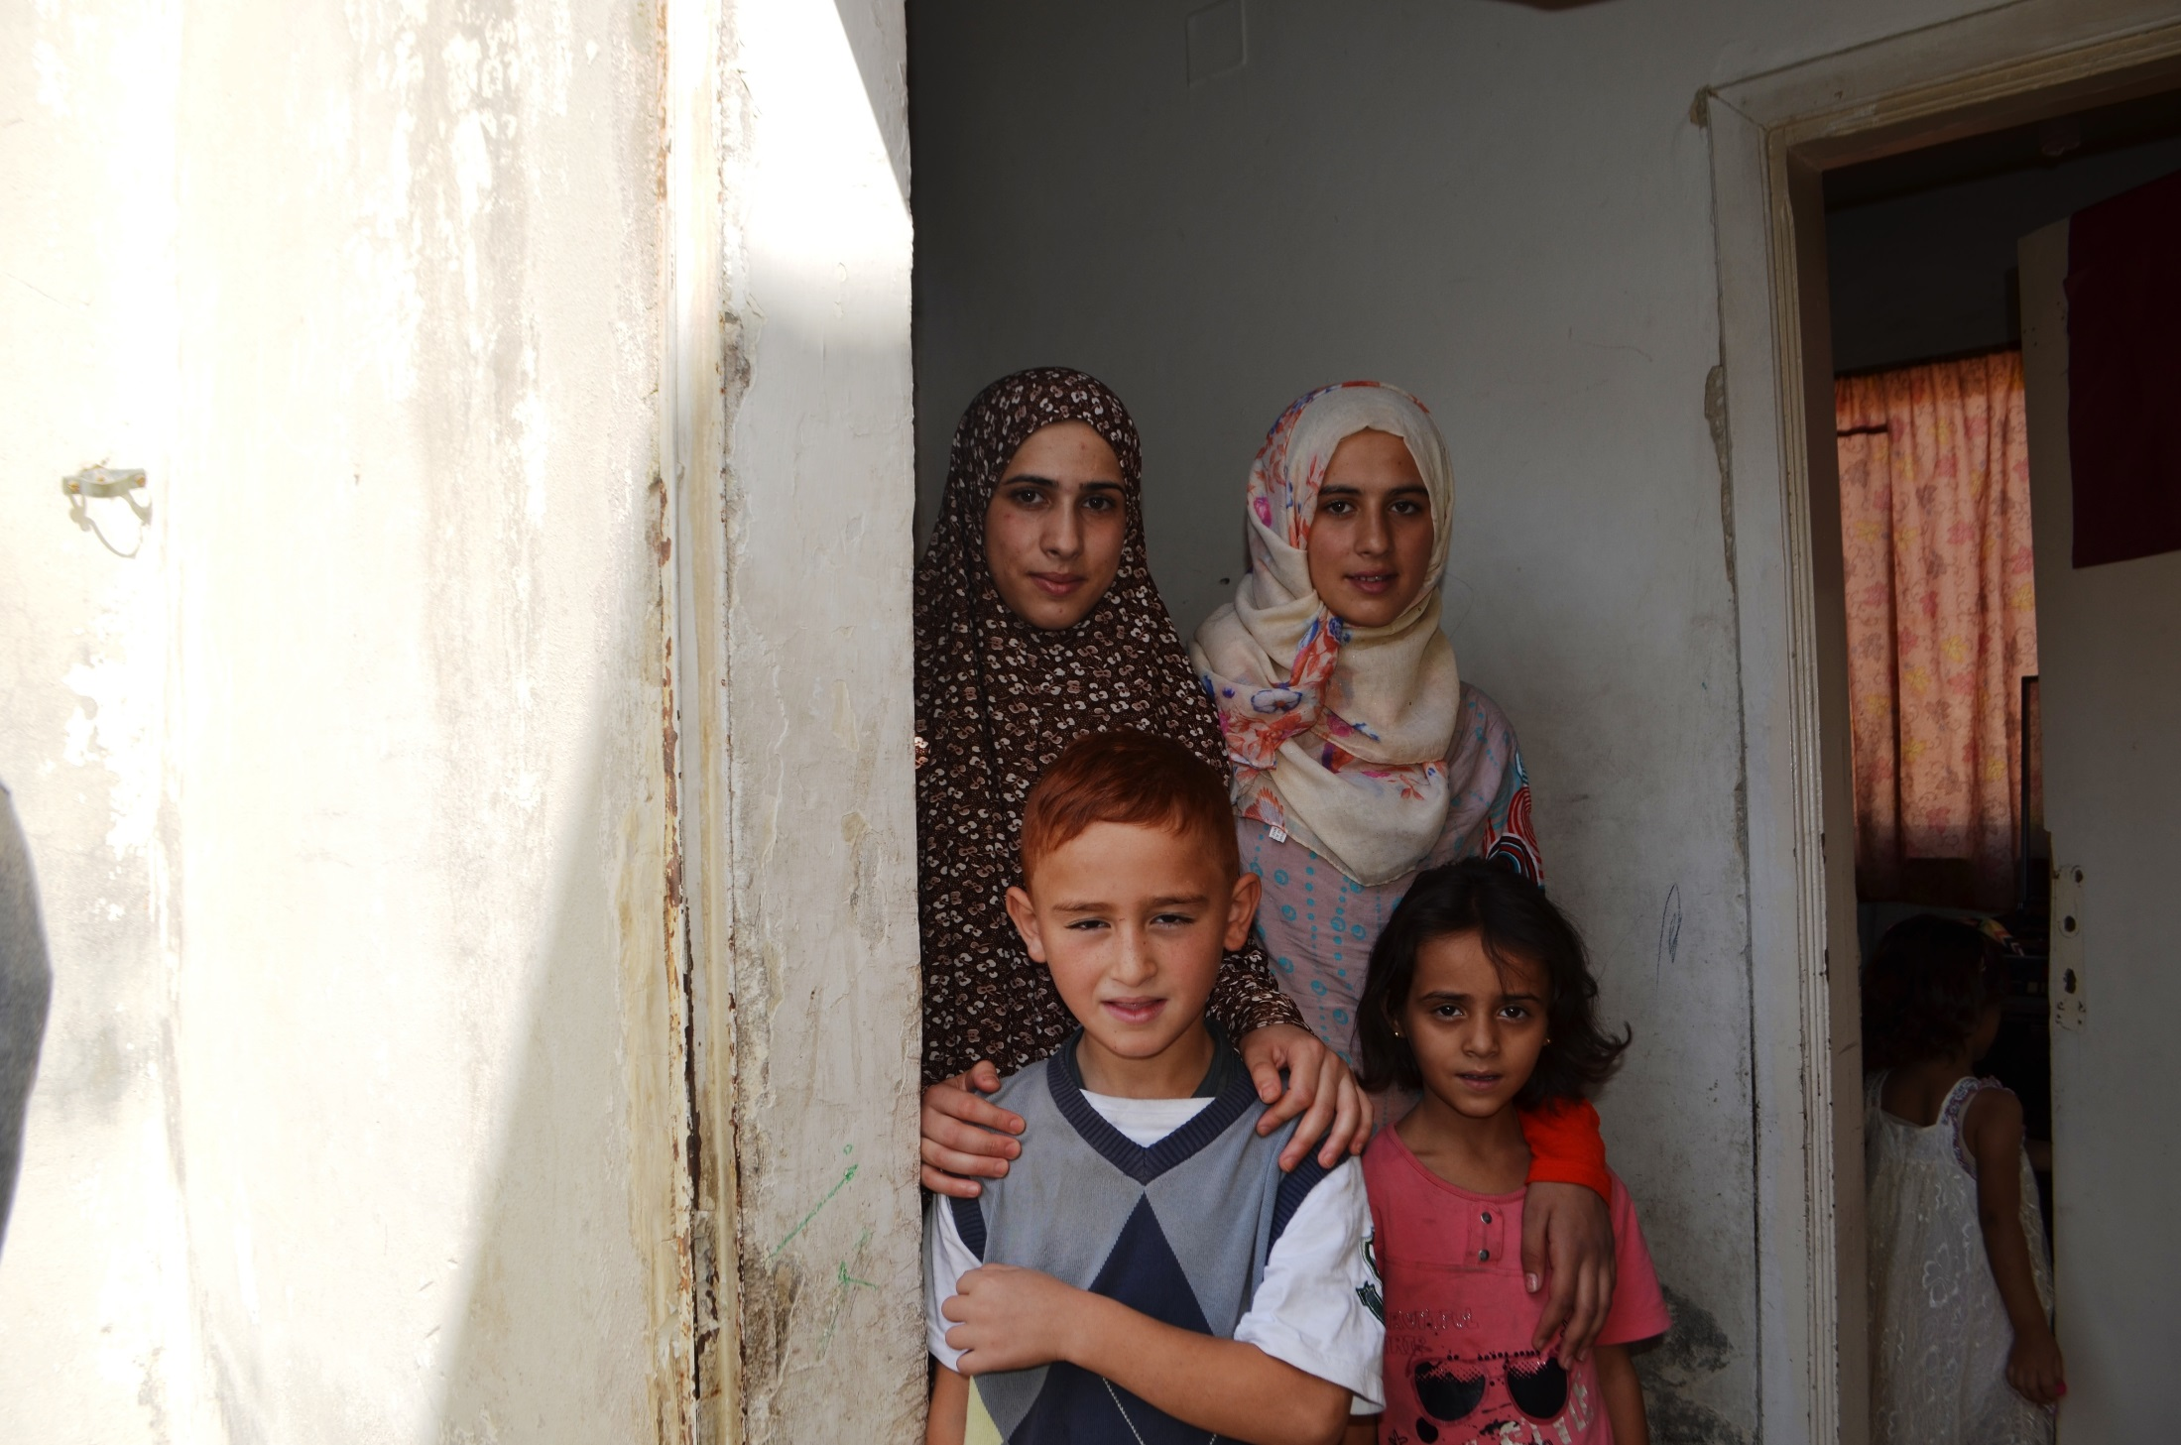
VULNERABILITIES ON THE RISE
Turkey
20% of the Syrians in urban areas have either borderline or poor food consumption scores.
Lebanon
70% of the refugee households live below the Lebanese extreme poverty line (USD 115 per month).
40% of refugees are now in debt to their landlords.
Jordan
86% of the Syrian refugees living outside of camps are living below the Jordanian poverty line (USD 96 per month)
Some 20% of children are abandoning school in order to work
Egypt
60% of Syrian refugees are severely vulnerable and 28% highly vulnerable
Iraq
Debt levels continue to increase. 25% increase in the proportion of refugees have sold their household assets between 2014 and 2015.

Slide 9
HUMANITARIAN AID ARCHITECTURE

Slide 10

REFUGEE COORDINATION- SYRIA SITUATION
Regional Refugee & Resilience Plan (3RP) 2015-2016
Country-driven process with regional coherence
Broad regional partnership strategy (close to 200 partners)
Platform for advocacy, fundraising, information management and monitoring
Evidence-based
One plan, five country chapters
Two year timeframe (2015-2016)
Total Funding Requirements 2015 (Refugee & Resilience) | US$ 5.5 billion
3RP Population Planning Figures by end-2015 | 4.27 million Syrian refugees
Notes:
3RP:
The 3RP represents a strategic shift in the approach to delivering aid for the region
Consultations took place at the global, regional and country levels under the co-leadership of UNDP and UNHCR.
The result: The 3RP was launched in Berlin on 18 December 2014.
UN Regional Directors, the Syria International NGO Regional Forum and the respective RC/HC offices agreed upon a 3RP Roadmap which describes the roles of various stakeholders, the timeframe and deliverables.
The 3RP recognizes the centrality of national resilience and stabilization plans
Seeks to strengthen national and sub-national capacities
Regional coherency and clear statement of the needs of and response plan for refugees and impacted communities
Envisioned as a broad regional partnership strategy – coordinated process between close to 200 partners
Based on national plans or processes
Platform for advocacy, fundraising, information management and monitoring
It is Articulated around two inter-linked refugee and resilience components;
Addresses refugee protection and humanitarian needs, and Strengthens the resilience of communities and governments to mitigate the impact of the Syrian crisis in the region.
The 3RP provides a framework to build on existing responses to not only meet refugee protection and humanitarian needs for the most vulnerable, but also address
the longer-term socio-economic impact of the Syria crisis on neighbouring countries.

Slide 11
3RP FUNDING STATUS – BY SECTOR
(as of 30 September)
Notes:
The sector funding data are collected on a quarterly basis. This is as of 30 September with the next funding status to be issued by the end of 2015.

Slide 12
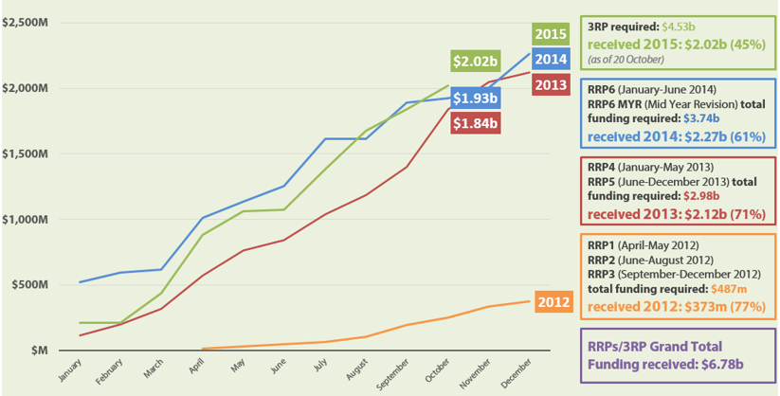
INTER-AGENCY FUNDING EVOLUTION
Notes:
Growing refugee needs and growing financial requirements since 2012
In dollar terms, the 3RP is slightly (USD 94 million) more funded at this point of 2015 than the RRP6 was at the corresponding point in 2014. Due to the relatively larger appeal in 2015, a larger gap can be found when comparing the funded percentage of the appeal (45%) with both the RRP6 (51%) and RRP5 (62%) were at the same point in 2014 and 2013.

Slide 13
Urban and Protracted Nature of Displacement

Slide 14
“The plight of refugees and others of concern in urban areas cannot be treated in isolation but needs to be responded to in the broader context of the urban poor. The humanitarian community needs to reassess its paradigm of assistance in urban areas. Humanitarian actors in urban areas need to determine how community-based and bottom-up initiatives can be better supported.”
UN High Commissioner for Refugees, Antonio Guterres

Slide 15
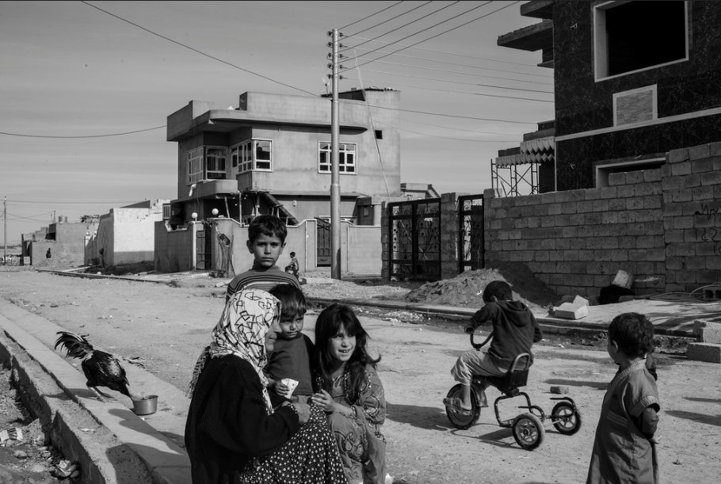
Nearly half of the total number of refugees and asylum seekers under UNHCR’s protection live in cities and towns
Refugees are drawn towards cities and towns as places promising better security and opportunity
In the absence of socio-economic support, safe housing, basic identity documents and necessary survival skills, refugees often find themselves ‘excluded’ in urban environments
Cities present obvious opportunities to stay anonymous, earn income, and build a better future

Slide 16
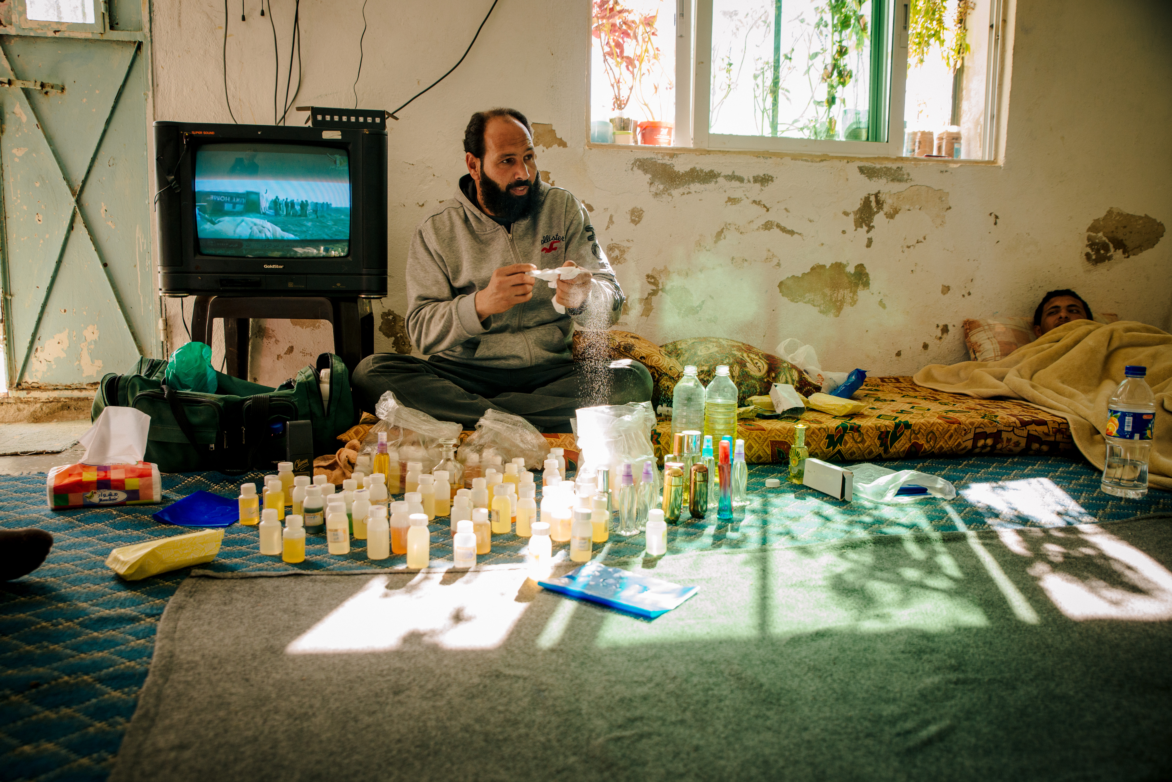
Commitment to the establishment of mechanisms that enable the organization to reach out to urban refugees in their communities and to ensure that they are aware of their rights and obligations, as well as the opportunities and services available to them
Commitment to upholding the social and economic standing of refugees, particularly by means of education, vocational training, livelihoods promotion and self-reliance initiatives
Key component of UNHCR’s work in urban areas is that of partnership, requiring the Office to establish effective working relationships with a wide range of different stakeholders
Notes:
Equity: In accordance with this principle, the Office will take action to ensure that all of the refugees living in an urban area can benefit from the available protection space and that they are treated in a consistent manner by UNHCR.
In urban contexts, municipal authorities and mayors have a particularly important role to play in the objective of expanding protection space, and UNHCR will consequently place particular emphasis on its relationship with these actors. At the same time, and in pursuit of the same objective, the Office will work closely with the national authorities, the police and judiciary, the private sector, NGOs, legal networks, other civil society institutions, development agencies and lately the private sector.
UNHCR’s activities in urban areas are based on the notion of equity. In accordance with this principle, the Office will take action to ensure that all of the refugees living in an urban area can benefit from the available protection space and that they are treated in a consistent manner by UNHCR.
This is not to suggest that the Office will necessarily adopt a uniform approach in relation to those refugees who are to be found in a given city or town. Indeed, the protection, solutions and assistance strategies pursued by UNHCR will be tailored to the specific circumstances, capabilities and vulnerabilities of different groups, households and individuals within the refugee population.
UNHCR recognizes that the establishment of partnerships with other actors in no way limits the responsibility of the Office to interact regularly and directly with refugees in urban areas. UNHCR is thus fully committed to the establishment of mechanisms that enable the organization to reach out to urban refugees in their communities and to ensure that they are aware of their rights and obligations, as well as the opportunities and services available to them.
UNHCR staff, especially those who have worked for many years with camp-based refugees, may lack the skills required to undertake effective outreach activities in urban areas. They may also be unfamiliar with the task of working with municipal authorities and local government institutions. To address these issues, UNHCR will review and revise as necessary the training and tools provided to its personnel.
Self-reliance
Finally, UNHCR’s work in urban (as in other) is based on a commitment to upholding the social and economic standing of refugees, particularly by means of education, vocational training, livelihoods promotion and self-reliance initiatives.
While these can be difficult tasks in situations where refugees are formally barred from the labour market and are not permitted to engage in income-generating activities, UNHCR will make every effort, in cooperation with the authorities, to ensure that urban refugees have access to such opportunities

Slide 17
The Innovation Imperative
Notes:
Innovation and effective delivery
The economic, social and human cost of caring for refugees and the internally displaced is being borne mostly communities who are unable to afford it, and therefore, innovative, efficient and collaborative approaches to protection and assistance must continue to be fostered.
Registation: Measures are being taken to ensure more efficient registration of refugees upon arrival in countries of asylum. In 2014, more than 716,000 individuals were registered in the MENA region. After implementation in Jordan and Lebanon, iris-scan biometric technology was deployed to Egypt and Iraq to register Syrian refugees. Other countries, such as Algeria, Mauritania and Morocco use finger-printing biometrics. So far, 69 per cent of refugees in the region have been registered using biometric technology.
Cash: The expansion of the use of monetization and cash-based assistance to vulnerable individuals and families is being pursued, in part due to the speed and efficiency with which cash is delivered to beneficiaries through ATM machines in countries neighboring Syria. The use of information and communication technology to communicate with refugees has grown significantly as well.
Cash-based assistance is more accessible and overcomes a major challenge of distributing assistance in an urban context where refugees are very widely spread. Withdrawing money from ATMs pose less of a security risk for both beneficiaries and humanitarian partners, and money is reinvested back into local economies. In addition, beneficiaries have the freedom to prioritize and are able to make their own choices about how to meet their needs, gaining a deeper sense of empowerment. They can shop at their local supermarket and be part of the local community, promoting tolerance, equity and dignity. In Jordan, refugees can access their cash assistance through a wide network of ATMs throughout the country. The ATMs use iris recognition technology (instead of a bank card) for withdrawals, minimizing fraud and the risk of theft.
Progress so far:
UNHCR strengthened biometric registration, enhanced its child protection activities including access to birth registration and SGBV prevention and response programmes, and worked closely with the authorities and partners to improve access of refugee children to national education systems. We built a growing body of evidence to inform programming and enhanced targeting to reach the most destitute. We strengthened cash assistance to provide refugees the freedom to prioritize and make their own choices and to reinvest into local economies. UNHCR has stepped forward in its response and will continue to do so for as long as the crisis persists.
IDP operation in Syria:
In Syria, UNHCR continues to support the IDP inter-agency coordination framework and the implementation of the strategic response plan, leading the sectors of protection, camp coordination and management, shelter and relief items. We used all possible means, working across conflict lines, to maximise delivery of assistance and protection inside Syria, despite the fact that safe and unhindered access to populations in need of assistance is not always provided. In 2014 alone, we distributed core relief items to 4.5 million people in Syria, including to over 1.1 million vulnerable IDPs in more than 100 hard-to-reach areas and across-borders. In 2015, 22,731 individuals (3,577 families) received cash assistance of approximately US$200 per family. Also in 2015, we have provided 1,151,105 individuals with 5,117,955 CRIs in 12 out of 14 Governorates in Syria.
In addition, we continue to reach people in need through the cross-border operations from Turkey and Jordan as authorized under the United Nations Security Council Resolutions.

Slide 18
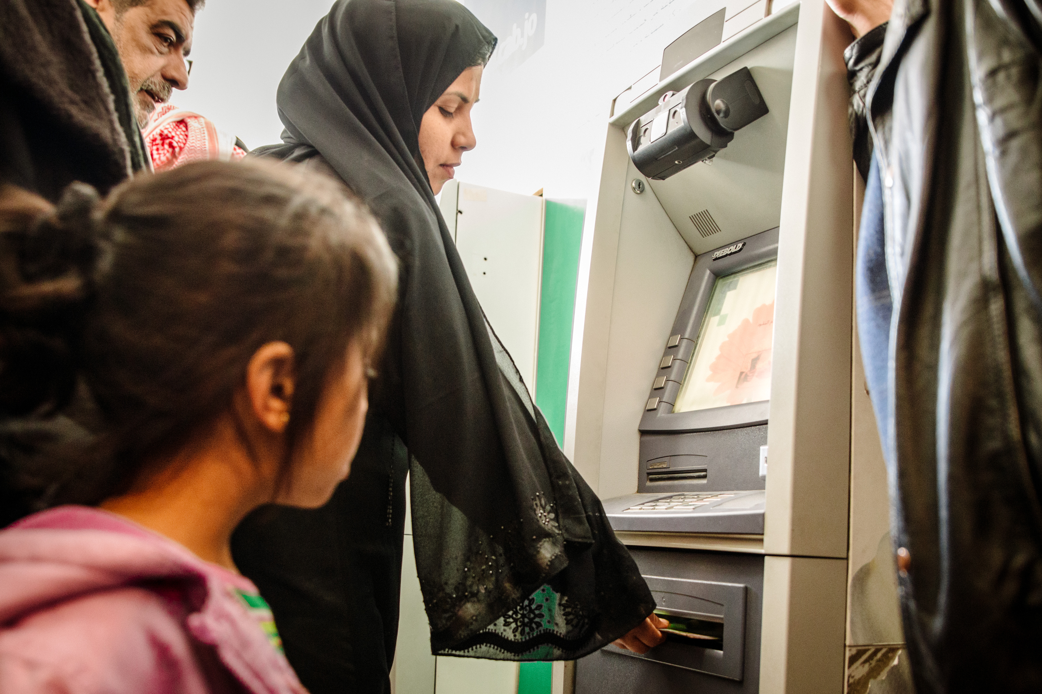
TECHNOLOGY
Given the challenging context and need to support refugees UNHCR has constantly worked on new technologies to facilitate access to services, including:
  Iris-scan biometric technology
  Refugee Assistance and Information System
  Information Sharing Portal
  Mobile Data Collection
  Two Way SMS System
  Automatic Data Collation
  Cash Assistance
  Websites for refugees
Notes:
The innovations and technologies provide creative solutions, leveraging the best of international and national partnerships in ways that help extend the impact of limited funding in a manner that brings tangible benefits to refugees and the communities in which they live.
UNHCR introduced the iris-scan biometric technology to ensure the efficient registration of refugees upon arrival in countries of asylum. By early 2015, 69% of refugees and asylum-sekers in the region had been registered using the technology – a faster, more secure and durable method to protect people and target assistance. In Jordan, biometric registration is linked with the world’s most advanced cash assistance programme for refugees, with careless and fraud-proof withdrawal of money from ATMs. Most importantly, it reinforces the dignity of refugees as they no longer have to go to a UNHCR office or line up to receive their cash assistance
Cash assistance:
Cash-based assistance is more accessible and overcomes a major challenge of distributing assistance in an urban context where refugees are very widely spread. Withdrawing money from ATMs pose less of a security risk for both beneficiaries and humanitarian partners, and money is reinvested back into local economies.
In addition, beneficiaries have the freedom to prioritize and are able to make their own choices about how to meet their needs, gaining a deeper sense of empowerment. They can shop at their local supermarket and be part of the local community, promoting tolerance, equity and dignity.
In Jordan, refugees can access their cash assistance through a wide network of ATMs throughout the country. The ATMs use iris recognition technology (instead of a bank card) for withdrawals, minimizing fraud and the risk of theft.
Iris Recognition Technology was initially implemented to streamline the refugee registration process, improving accuracy and efficiency whilst working to prevent double registration.
Other implemented innovative projects include the Refugee Assistance and Information System (RAIS), Information sharing portal (accessed via UNHCR website), Vulnerability Assesment Framework, Mobile data collection, two-way SMS system, and Automatic Data collation tool

Slide 19
COMMUNICATION WITH BENEFICIARIES
Communications with refugees is a key element of UNHCR’s protection and operational response in the MENA region
UNHCR introduced a number of means of communication to help refugees and stakeholders to be better connected to the good and services, essential in addressing challenges
Addresses refugees concerns on numerous levels including: Shelter, Basic needs, Education, Food Security, WASH, Protection and Livelihood.
Achieved through two-way communication mechanisms
Notes:
What: Communications with refugees is a key element of UNHCR’s protection and operational
response in the MENA region, and an issue in which there is a growing level of interest within the
organization and among external stakeholders. This communication addresses refugees concerns
on numerous levels including: Shelter, Basic needs, Education, Food Security, WASH, Protection
and Livelihood.
Why: Because we have a vision where Syrian refugees are informed about services and assistance
provided by humanitarian actors involved in the Syria Regional Response Plan and are included in
decisions that affect their lives through two-way communication mechanisms.
How: Two-way communication is vital to ensure that communities are not passive recipients
of the messaging of agencies, but also active participants in the dialogue with those agencies
on vital issues affecting their lives. Communication with refugees revolves around information
sharing between UNHCR and beneficiaries of programs, including refugees, members of host
communities or other affected populations.

Slide 20








Communication with refugees revolves around information sharing between UNHCR and beneficiaries of programs, including refugees, members of host communities or other affected populations, through:
  Social Media Channels
  Traditional Media Tools
  Mobile Communication
  Home visits
  Call Center and Help Line
  Website
  Daily filtration and Counselling
Notes:
Social Media Channels
We successfully utilized social media channels (Facebook & twitter) in all MENA countries as a communication tool
with refugees. In Lebanon one Refugee Outreach Volunteers (ROV) group in particular created a Facebook page where
supporting information is provided, and in 3 months reached 3,000 followers. UNHCR guides, monitors and support
the page to ensure the information is correct.
Traditional Media tools
We utilized local media services and tools in order to publish informative material and keep refugees updated such
as; TV’s, Radio stations, newspapers and magazines. Also, we distribute brochures and flyers, for example: 2 million
informative brochures about the upcoming winter have been distributed with food packages recently in Syria.
Mobile communication
Through regular and WhatsApp messaging, we are able to communicate with refugees, and update them about
anti-fraud messages, resettlement messages…etc. for instance, Lebanon has a communications tree by which ROV
receive information flowing from the Beirut Office, to the Field Office focal points, and then to the ROV Part-ner focal
points. The ROVs receive and share information by WhatsApp, and the flow of communication is two-way. While in
Jordan talking with Refugees through WhatsApp in Arabic is being implemented, as part of the over-all UNHCR plan
for communication with refugees in Jordan. The App is managed by an editor and all contributions are checked before
being sent, so that they are in line with UNHCR policies. These communications have as recipi-ents all refugees with
access to a smartphone, sharing text, photos, audio or even video messages.
Home visits
Home visits are being conducted on monthly basis, in order to discuss refugees’ main concerns and gaps and to be able
to suggest solutions face to face. In Turkey house visits are being carried out reaching to refugees in their city of residence,
as well as indi-vidual and group meetings. An important mediation role between refugees and local authorities
is con-ducted, following up on highlighted issues with au-thorities on the spot, also follow up missions are conducted
to measure the impact of advocacy with authorities at central and local level.
Call Center and Help Line
We are always connected with beneficiaries through direct hot-lines where they can get direct ansewrs about their
questions and concerns. For instance in Iraq, more than 45,496 calls were received from the beginning of 2015 until
today.
Website
Updates and information are easily shared through our websites with refugees, in order to keep them updated about
the status of their cases (Resettlement, RSD and financial request results). Lebanon’s websites witnessed around
83,000 views during September only.
Daily filtration and Counseling
One on one visits and interviews with beneficiaries are taking place in all camps by UNHCR qualified team.
1,781 counsling and help desk interviews were conducted during 2015 in Jordan. While a written case study was
conducted by Syria on its training of trainers programme for UNHCR, partners and volunteers on citizen media awareness
and communication essentials.

Slide 21
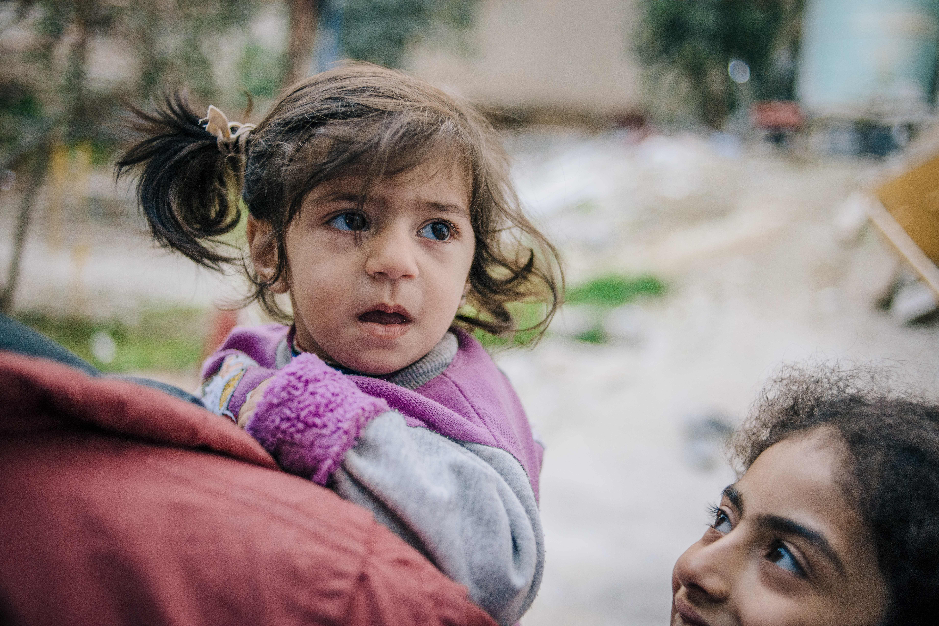
Partnerships and Advocacy

Slide 22
All countries in MENA are impacted by displacement as country of origin, country of asylum, country of transit, donor or a combination of these categories
Main area of focus has been to look at the design and development of partnership policies and stronger relations with civil society actors across the region
Building a regional network which would act as a base for advocacy to widen protection space, and for support and impact on local engagement with and decision making related to displacement
Establishment of a MENA Civil Society Network for Displacement would amplify the voices of supporters and advocates across the region

Slide 23
CIVIL SOCIETY NETWORK
Development of network for national and regional civil society actors involved with advocacy, program implementation, research, resource mobilization, media, or otherwise
UNHCR as catalyst and convener
A process of mapping and analysis of stakeholders, discussions with field offices and select partners at various fora, an outreach toolkit to new partners (all in English and Arabic), have been developed.
A network secretariat would be formed, which would continue to drive the process forward, in close collaboration with UNHCR.

Slide 24
ACADEMIA AND THINK TANKS
  The Center for Migration and Refugee Studies in Cairo
  Issam Fares Institute for Public Policy, Beirut
  Center for Strategic Studies in Amman, Amman
  Asfari Institute for Civic Engagement and Citizenship, Beirut
  Columbia Middle East Research Center, Amman
  West Asia North Africa (WANA) Institute, Amman
  New York University Abu Dhabi;
  Hult International Business School, Abu Dhabi
  INSEAD, Abu Dhabi;
  Konrad Adenaur Stiftung, Amman and Beirut
  Institute for Migration Studies, Beirut
  Arab Thought Forum, Amman
  Open Society Foundation, Amman
  Refugee Studies Centre, Oxford
  Center for Women’s Studies, Amman
  Cynthia Nelson Center for Gender Studies, Cairo

Slide 25
PARTNERSHIPS
NGOs: Iraqi Salvation Humanitarian Organization (ISHO), The Jordanian Hashemite Fund for Human Development, International Islamic Relief Organization, Human Rights Committee, Royal Charity Organization, Zakat House, Amel Association, Frontiers Ruwad Association, Association pour la Développement Humain en Mauritanie, IRD : Institut de Recherche pour le Développement, Al-Bena Organization, Islamic Relief, The Humanitarian Forum, Jordan Hashemite Charity Organization, Muslim Aid, Egyptian Foundation for Refugee Rights, Middle East Council of Churches Legal Aid
Foundations: Big Heart Foundation, Noor Al Hussein Foundation, EWA’A Centers for Women and Children, Arab Human Rights Fund, RAF, Qatar Charity, Qatar Red Crescent, Qatar Foundation, Emirati Red Crescent, Dubai Cares, Sheikh Mohammed bin Rashid Al Maktoum Foundation
Think Tanks/Research Institutes: Group 29, Resource Center for the Displaced (University of Balamand), DAAD, Refugees, Displaced Persons and Forced Migration Studies Center, Amman Center For Human Right Studies, Al-Ahram Center for Strategic Studies, Lebanese Emigration Research Center, Emirates Center for Strategic Studies and Research, Lebanese American University, Birzeit University, Cairo Institute for Human Rights Studies, Arab Institute for Human Rights, Syrian Center for Policy Research, Foundation for the Future, Issam Fares Institute, Asfari Institute, The Arab Thought Forum, Center for Migration and Refugee Studies
Notes:
Partnerships
The challenges we face today demand a coordinated and comprehensive response and therefore, partnership is key across the region. Cooperation with other multilateral regional organizations including the League of Arab States and the Organization of Islamic Cooperation Committee (OIC) continue to advance significantly in order to widen protection space of displaced persons in the Arab and Muslim world.
UNHCR has been working closely on mobilizing public, political, financial and operational support through strategic partnerships, UNHCR’s advocacy with public and private entities in the GCC countries resulting in substantial contributions for UNHCR operations.
In February of this year, an innovative Partnerships Platform for partners in the private sector interested in contributing to UNHCR was launched, and will continue to develop in the coming months. This is the first such online platform of its kind and has the potentially to galvanize heightened support from new stakeholders.
Civil society continues to be a crucial partner for UNHCR in the region. In 2015, plans are underway towards establishing a “MENA Civil Society for Displacement Network” to provide a platform for civil society associations and NGOs in the region.
Plans are underway to develop a MENA-wide network of local and regional civil society actors to strengthen advocacy on displacement issues, build national capacities and share lessons learned on an array of issues, including emergency response and protection.

Slide 26
Refugee Agency

Slide 27
LIVELIHOODS AS AGENCY
Refugees are often confronted with a wide range of barriers in efforts to establish sustainable livelihoods. Such barriers include:
  Legal
  Financial
  Cultural
  Linguistic
Refugees often find themselves competing with large numbers of poor local people for jobs that are hazardous and poorly paid
UNHCR supports the efforts of urban refugees to become self-reliant, both by means of employment or self-employment
Notes:
Urban refugees are often confronted with a wide range of legal, financial, cultural and linguistic barriers in their efforts to establish sustainable livelihoods. In many cases, they have little alternative but to join the informal economy, and as a result of overcrowding created by urbanization, they often find themselves competing with large numbers of poor local people for jobs that are hazardous and poorly paid. In some cases, employers may actually choose to engage refugees rather than nationals, but only because they are less likely to complain or seek redress if they are treated unfairly.
To the extent possible, in respect of national laws and in close cooperation with the authorities, UNHCR supports the efforts of urban refugees to become self-reliant, both by means of employment or self-employment. In pursuit of that objective, the Office works in close partnership with the authorities, development agencies, microfinance organizations, banks, the private sector and civil society institutions, especially those that have experience in the area of livelihoods and have a good knowledge of local market constraints and opportunities.
One of the most difficult questions confronting UNHCR in urban contexts is whether to promote refugee livelihoods and self-reliance in countries where they are denied the right to gain an income under national law and practice. UNHCR will in the first instance explore every opportunity to encourage the authorities to be more flexible in their legislation and practice so as to facilitate the economic activities of urban refugees.
In such situations, UNHCR’s will explore the opportunities that exist to support the efforts of refugees to become self-reliant in an unobtrusive manner, focusing on activities such as the establishment of small-scale and home-based enterprises. UNHCR’s advocacy efforts will draw attention to the fact that providing refugees with skills is a valuable way of retaining their dignity, maintaining their social capital, preparing them for durable solutions and alleviating any pressure they might place on national services and welfare systems.

Slide 28

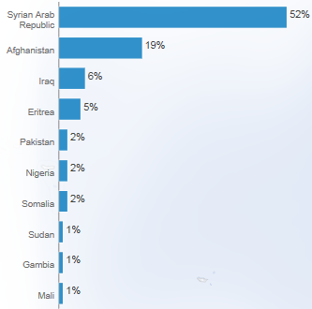
MOVEMENT TO EUROPE AS AGENCY
Seven factors behind the movement are;
Loss of hope
High costs of living/Deepening poverty
Limited livelihood opportunities
Aid shortfalls
Hurdles to renew legal residency
Scant education opportunities
Feeling unsafe
Notes:
Reasons for onward movement
The spike in Syrian refugees arriving in Europe, including from Syria directly, is mainly due to the loss of hope that a political solution and for their future. Among the main reasons for onward movements of refugees from the region, which is expected to increase (according to ongoing intention surveys) are limited livelihood opportunities (access to income), hurdles to renew legal residency, and limited education opportunities. The cuts in humanitarian assistance have also been a trigger, as their impact was immediately felt by the refugee community.
The spike in Syrian refugees arriving in Europe, including from Syria directly, is mainly due to the loss of hope that a political solution and for their future. Among the main reasons for onward movements of refugees from the region, which is expected to increase (according to ongoing intention surveys) are limited livelihood opportunities (access to income), hurdles to renew legal residency and limited education opportunities. The cuts in humanitarian assistance have also been a atrigger, as their impact was immediately felt by the
UNHCR’s monitoring
In all operations in the region, UNHCR and partners are undertaking efforts, through regular protection monitoring and interventions (border monitoring, continuous registration, surveys, key informants as well as interaction with refugees, including focus-group discussion) to continuously improve understanding and analysis of movement trends. In this context, it is important, however, to note, that information in terms of the volume of such movements, is not comprehensive. There are Syrians staying in countries in the region who are not registered with UNHCR and for whom limited information is available.

Slide 29
Notes:
Asylum Trends in Europe- New Asylum
Jan-Oct 2015: EU 877,258 new asylum applications compared to 443,149 for same period in 2014, Europe-38 1,350,163 compared to 556,556 same period 2014 (provisional data, no data for September and October for some countries).
o Top receiving countries in the EU Jan-Oct 2015: Germany (315,150), Hungary (173,503), Sweden (106,919), France (47,694) and Italy (47,428).
o Top nationalities in the EU: Syria, Afghanistan, Serbia and Kosovo (S/RES 1244 (1999)), Iraq, Albania.
o Top receiving countries in Europe 38 Jan-Sep 2015: Serbia and Kosovo (S/RES 1244 (1999)) (335,301), Germany (315,150), Hungary (173,503), Turkey (89,299), and Sweden (106,919).
o Top nationalities in Europe 38: Syria, Afghanistan, Iraq, Serbia and Kosovo (S/RES 1244 (1999)) and Albania.
o Total new asylum applications 2014: 565,241 in the EU and 708,676 in 38 countries in Europe.
o In 2014, EU States together accounted for 80% of all new asylum claims submitted in Europe. Germany and Sweden accounted for 44% of asylum claims in the EU.
o Overall protection rate EU in second quarter of 2015: 46% (Eurostat, see here).
Syrians in Europe o
Beginning of conflict Apr 2011- Sep 2015: 468,299 new asylum applications of Syrians in the EU+ (125,666 in 2014) and 679,240 in 37 countries in Europe (137,947 in 2014).
o These numbers represent slightly more than 10% of Syrians who have fled the conflict seeking safety in Europe (excluding Turkey, where the authorities have registered over 2 million Syrian refugees).
o Two countries - Germany and Sweden - have received 53% of all applications in EU+.
o Including the next top 5 countries (Hungary, Austria, the Netherlands, Bulgaria and Denmark) the total reaches 85% of all new asylum applications from Syrians in the EU+.
o Protection rate EU in 2014: 95% (51% refugee status, 43% subsidiary protection and 1% humanitarian reasons) (Eurostat, see annual report). Second quarter of 2015: 95% (73% refugee status, 22% subsidiary protection) o Syrians are the number 1 nationality of sea arrivals in the Mediterranean in 2015 with 52% of all arrivals, and 63% of the arrivals in Greece (as of 29 of October).
o Total pledges for Syrian resettlement and other forms of admission: 130,408 (85,492 from European countries).

Slide 30
Crisis of Hope

Slide 31
Way Forward
Political crisis requires a political solution
Global refugee protection regime predicated on solidarity and responsibility-sharing
Rise of violent extremism, association of refugees with terrorists, whereas they are fleeing terror
Future positions of Europe and critical role of civil society, academia, media
Partnerships for more comprehensive, holistic, and more localized responses

