Slide 1
Education – what is it good for? Formal and informal education in Syria 1980-2010
Annika Rabo, Marianne Boqvist, Zeina Bali

Slide 2
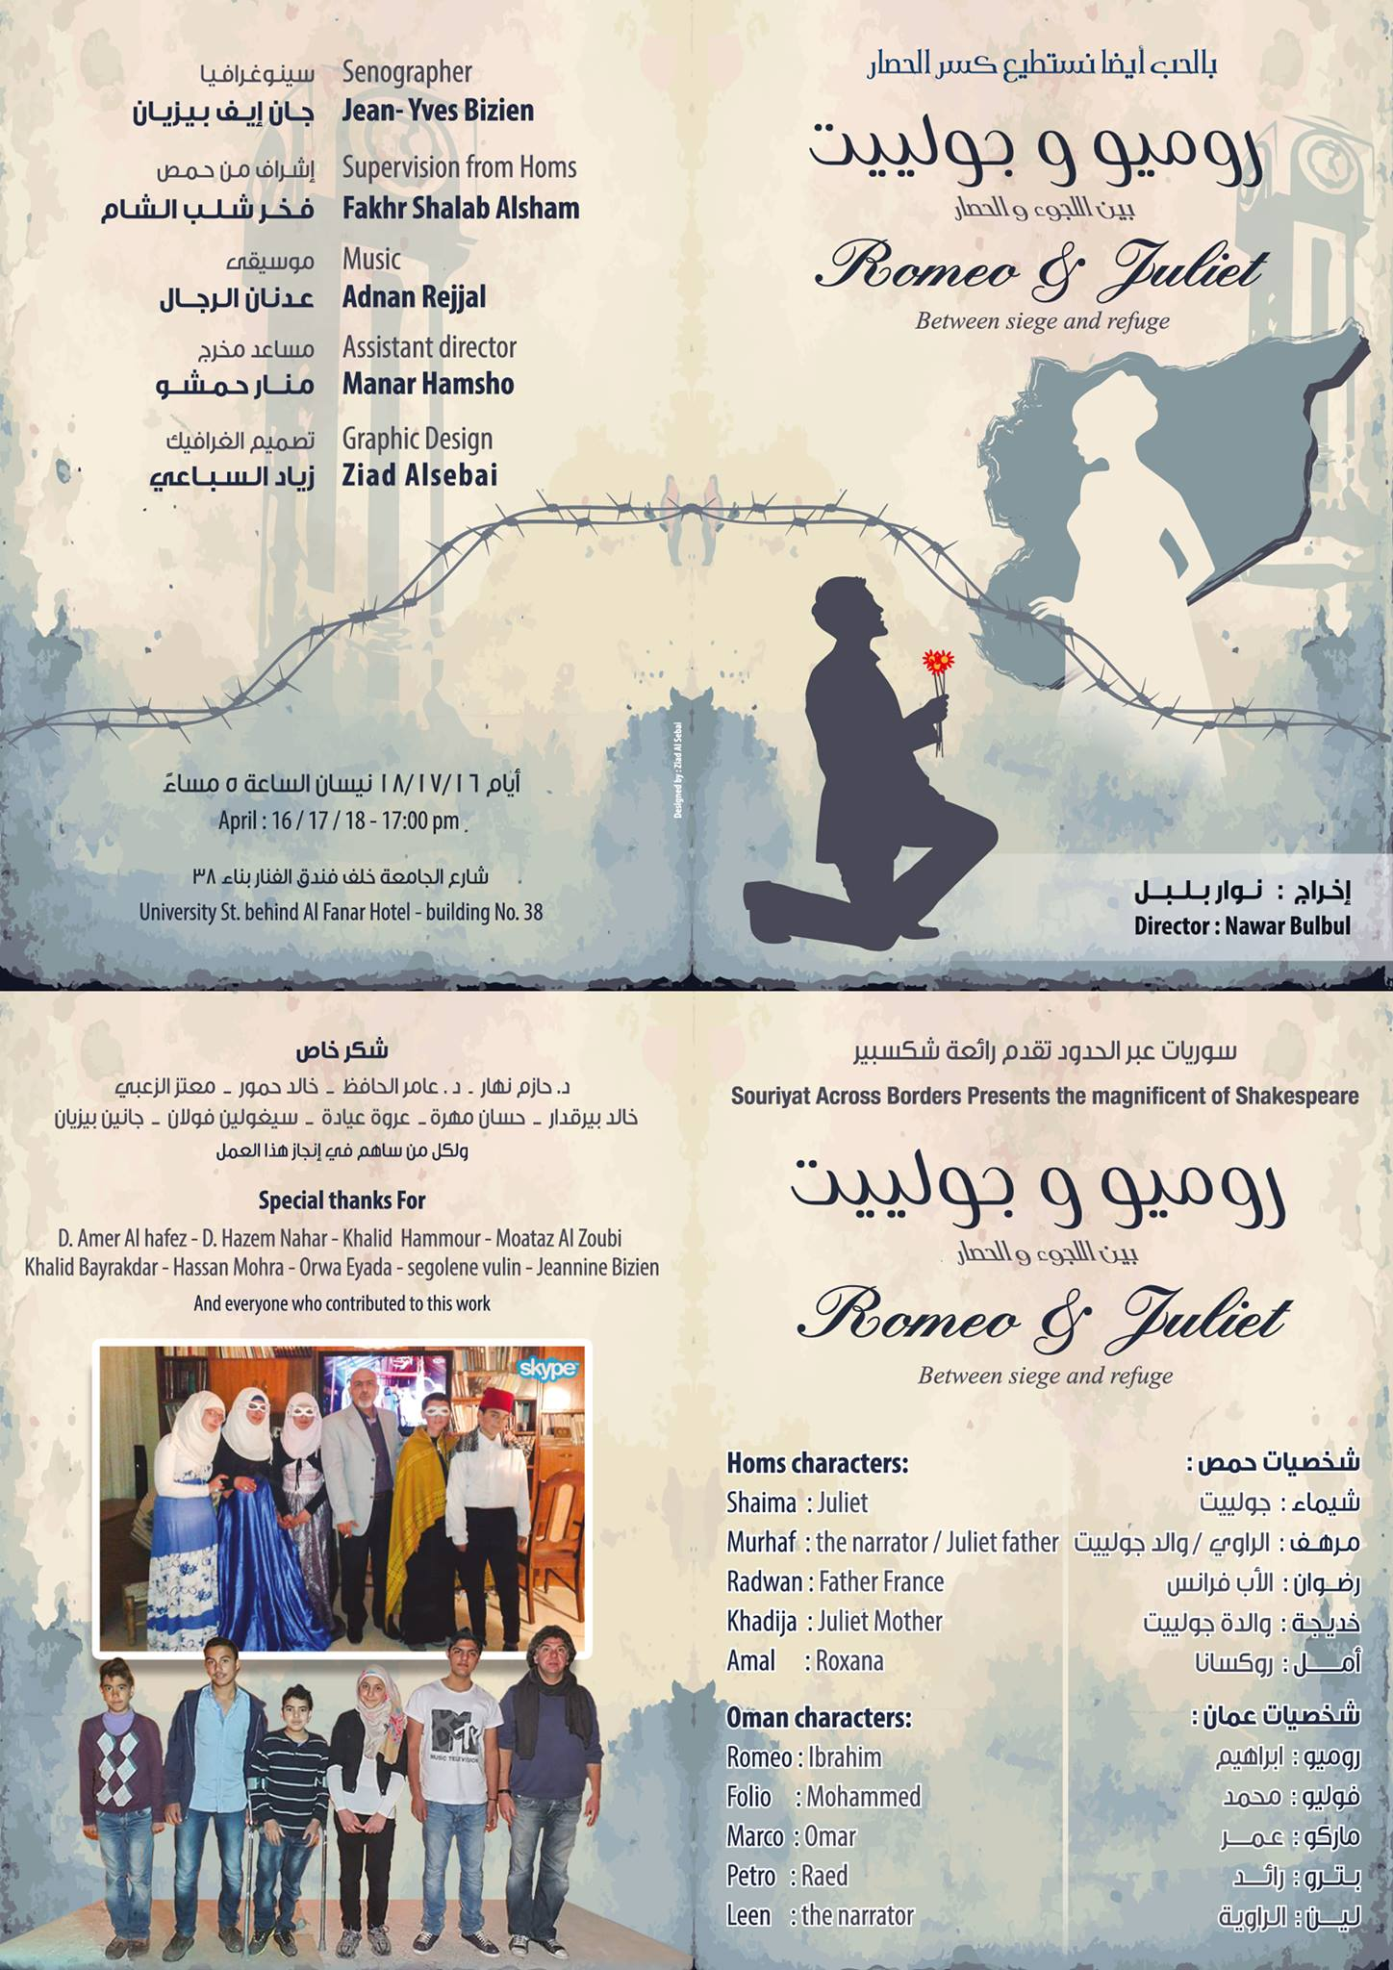
Syrian Romeo and Juliet via Skype

Slide 3
1960s: Nationalisation of educational institutions. Equality
1990s: Private educational institutions. Disparities

Slide 4
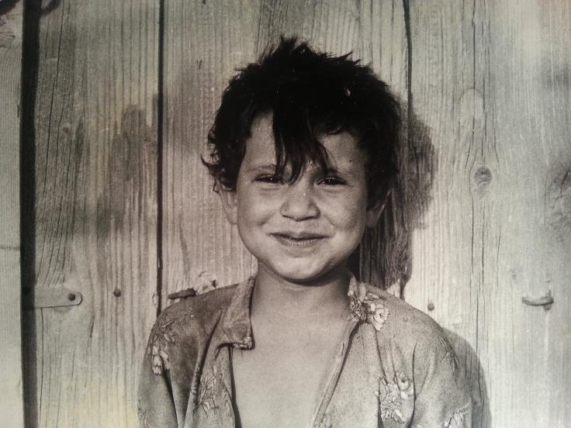
Countryside of Raqqa 1979

Slide 5
Arab nationalism in curricula and textbooks
Student essays 1988:
“my aspiration is to become a doctor or a pharmacist”,
“I want to study mechanical engineering to serve others to build the society and its civilisation”,
“for Syria I hope we continue the road towards economic, social, industrial and agricultural progress”

Slide 6
Hidden curricula “Domination, privilege and fear”
Majority domination of minority
Bribes to teachers
Punishments common in schools

Slide 7
Monocultural vision and ideology
Need to develop conviviality in education

Slide 8
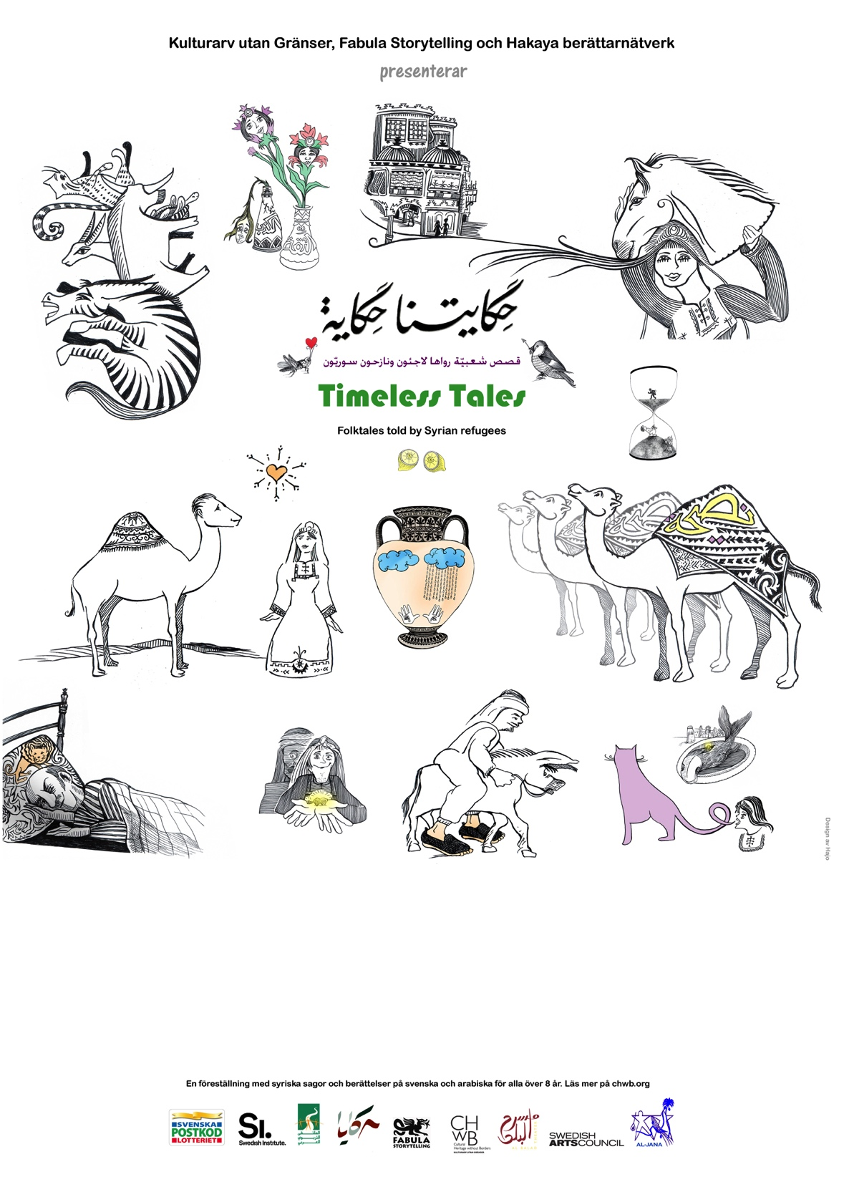
Informal education

Slide 9
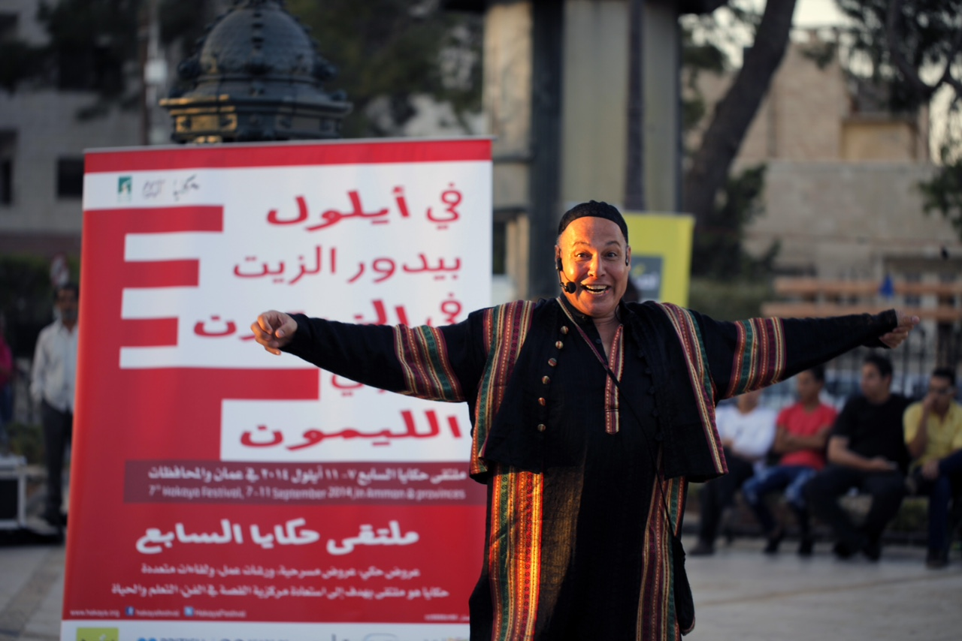
Al-Hakawati project
Nemer Salamoun, Hakaya festival, Amman, Jordan 2014

Slide 10
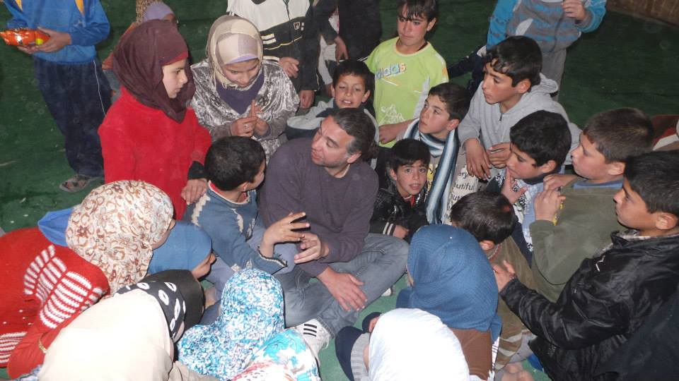
Shakespeare in Zaatari

Slide 11
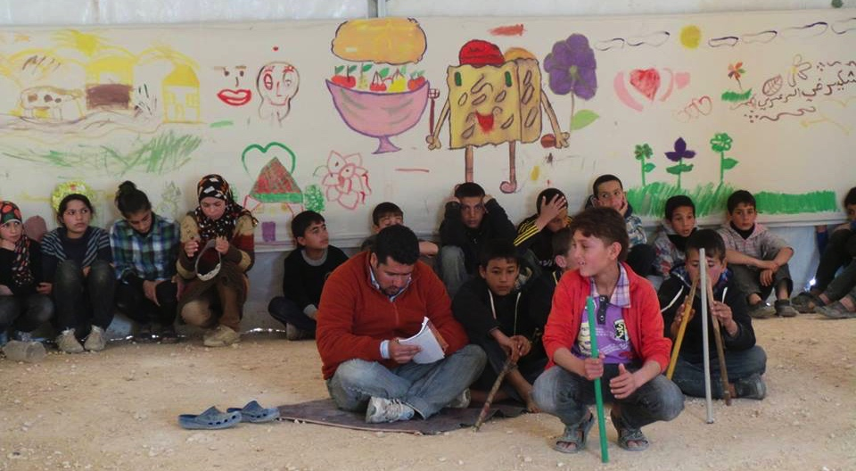

Slide 12
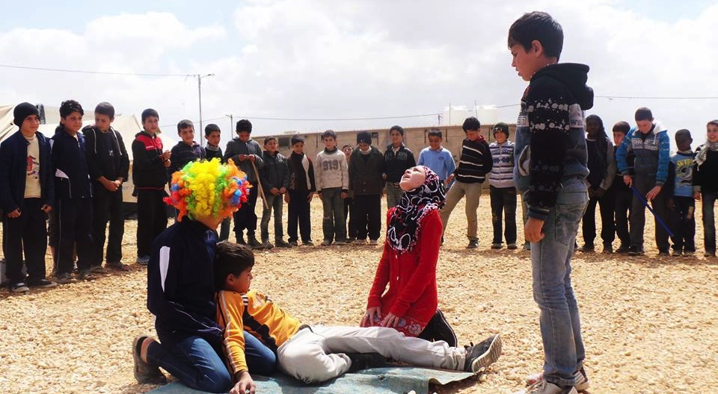

Slide 13
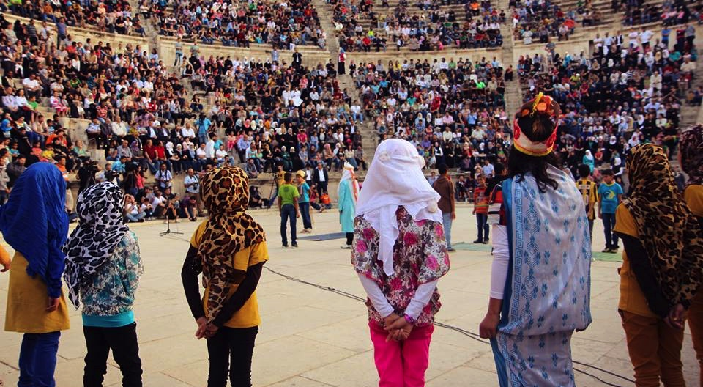

Slide 14
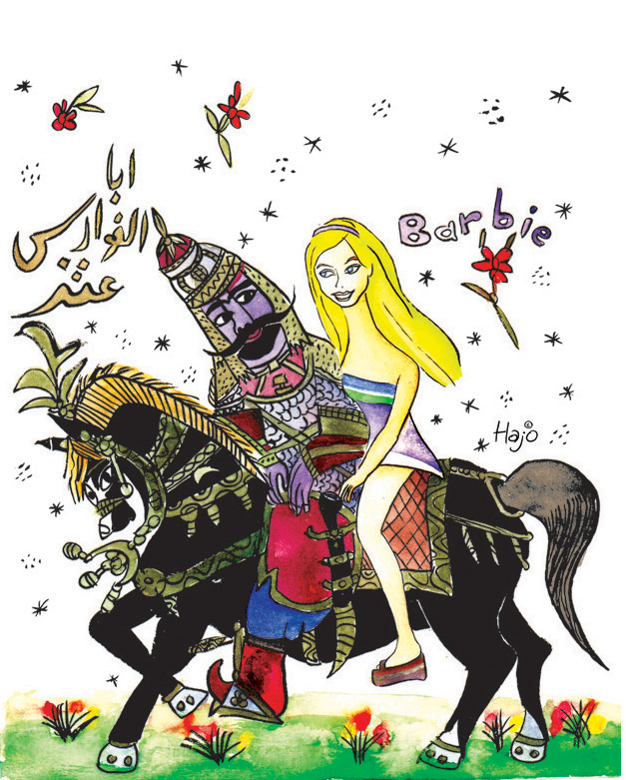
Prospects for a future more inclusive and critical education?
Saad Hajo, Syrian caricaturist, resident in Sweden

