Slide 1

After the Universal Declaration of Human Rights:
In the footsteps of Felix Ermacora’s UN service (1960-1995)
Dr Alvina Hoffmann
SOAS University of London

Slide 2
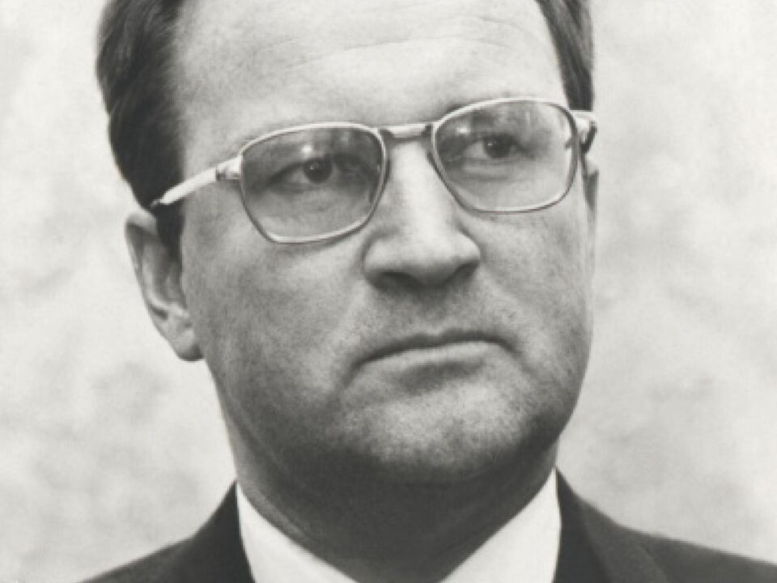
“Even though [Felix Ermacora] no longer belongs to the generation of great personalities such as René Cassin, Eleanor Roosevelt, Charles Malik or Sir Hersch Lauterpacht, who anchored the idea of international human rights protection in international law in the post-war period, he experienced the suffering of the Second World War as a soldier himself and from the 1950s onwards dedicated his life to the protection of international human rights”
Felix Ermacora, 1932 - 1995

Slide 3
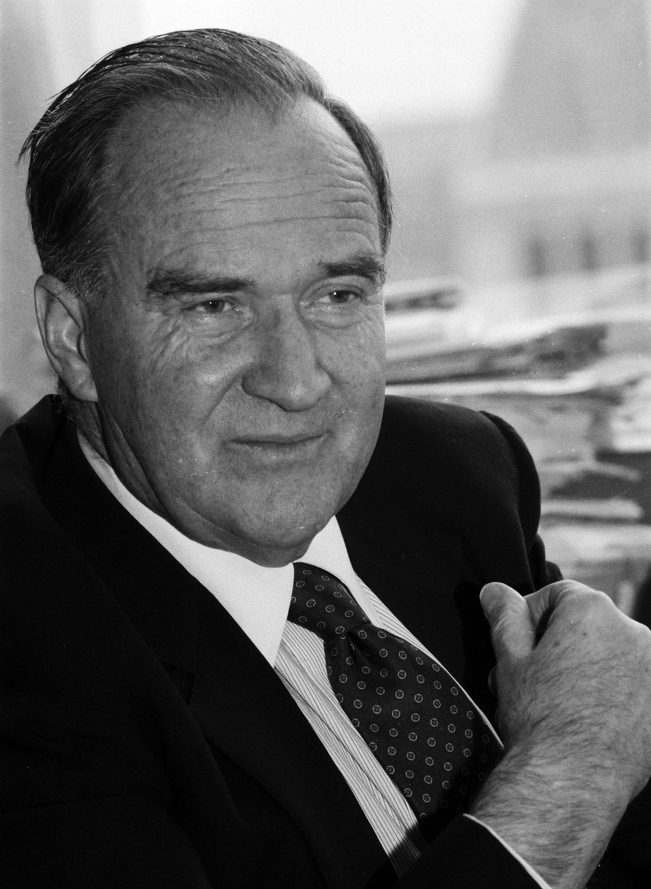
From Austria to the United Nations
Born 13 October 1923 in Klagenfurt, Carinthia
Abitur in Regensburg, 1942
joined the Wehrmacht of Nazi Germany as a soldier of the Bavarian first Alpine Division
Not required to register as a former member of the NSDAP during Austria’s denazification
Studied law and government at the University of Innsbruck and Sorbonne (1945-1949)
Career in academia and state civil service
Minority rights: central academic and political question
Politician (1971 – 1990)

Slide 4
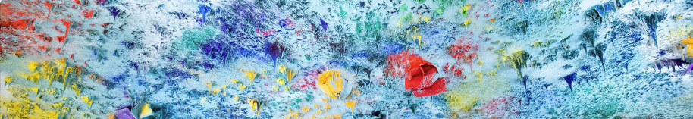
UN service
Austrian delegate to Commission on Human Rights from 1960 onwards: rapporteur (1960, 1968), vice-chairman (1961, 1970), chairman (1974), representative of Austrian delegation to Teheran Conference on Human Rights in 1968
Member of the Austrian delegation to the UN General Assembly (1960, 1963, 1970, 1971, 1979)
fact-finding missions on South Africa (1967-1995), the occupied Palestinian territories (1969-1971), Chile (1975-1979) and Afghanistan (1984-1995)

Slide 5
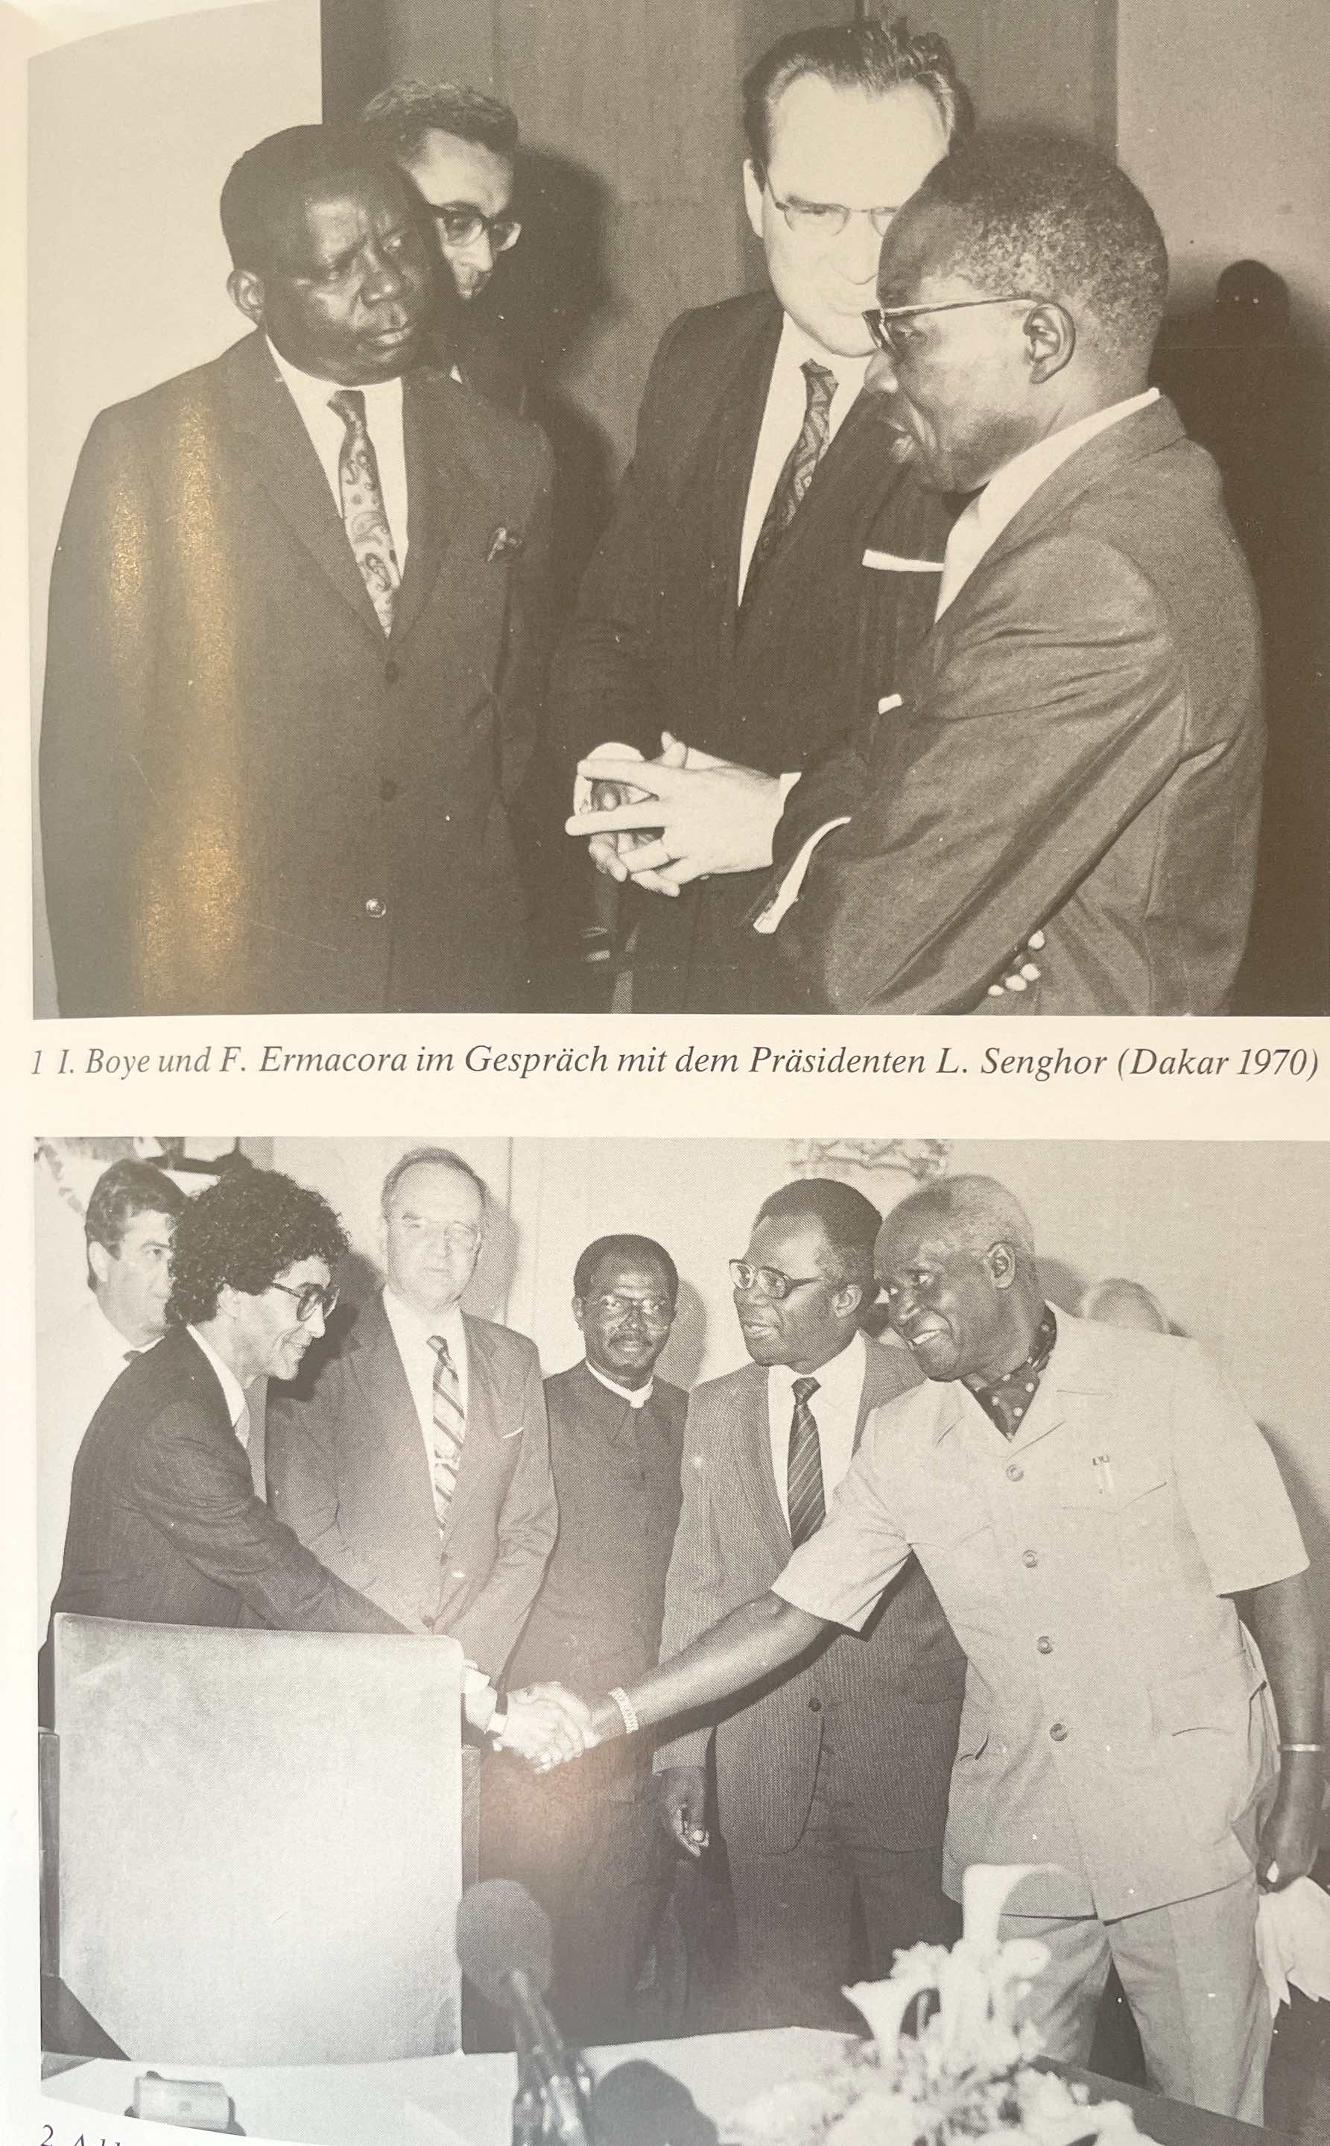
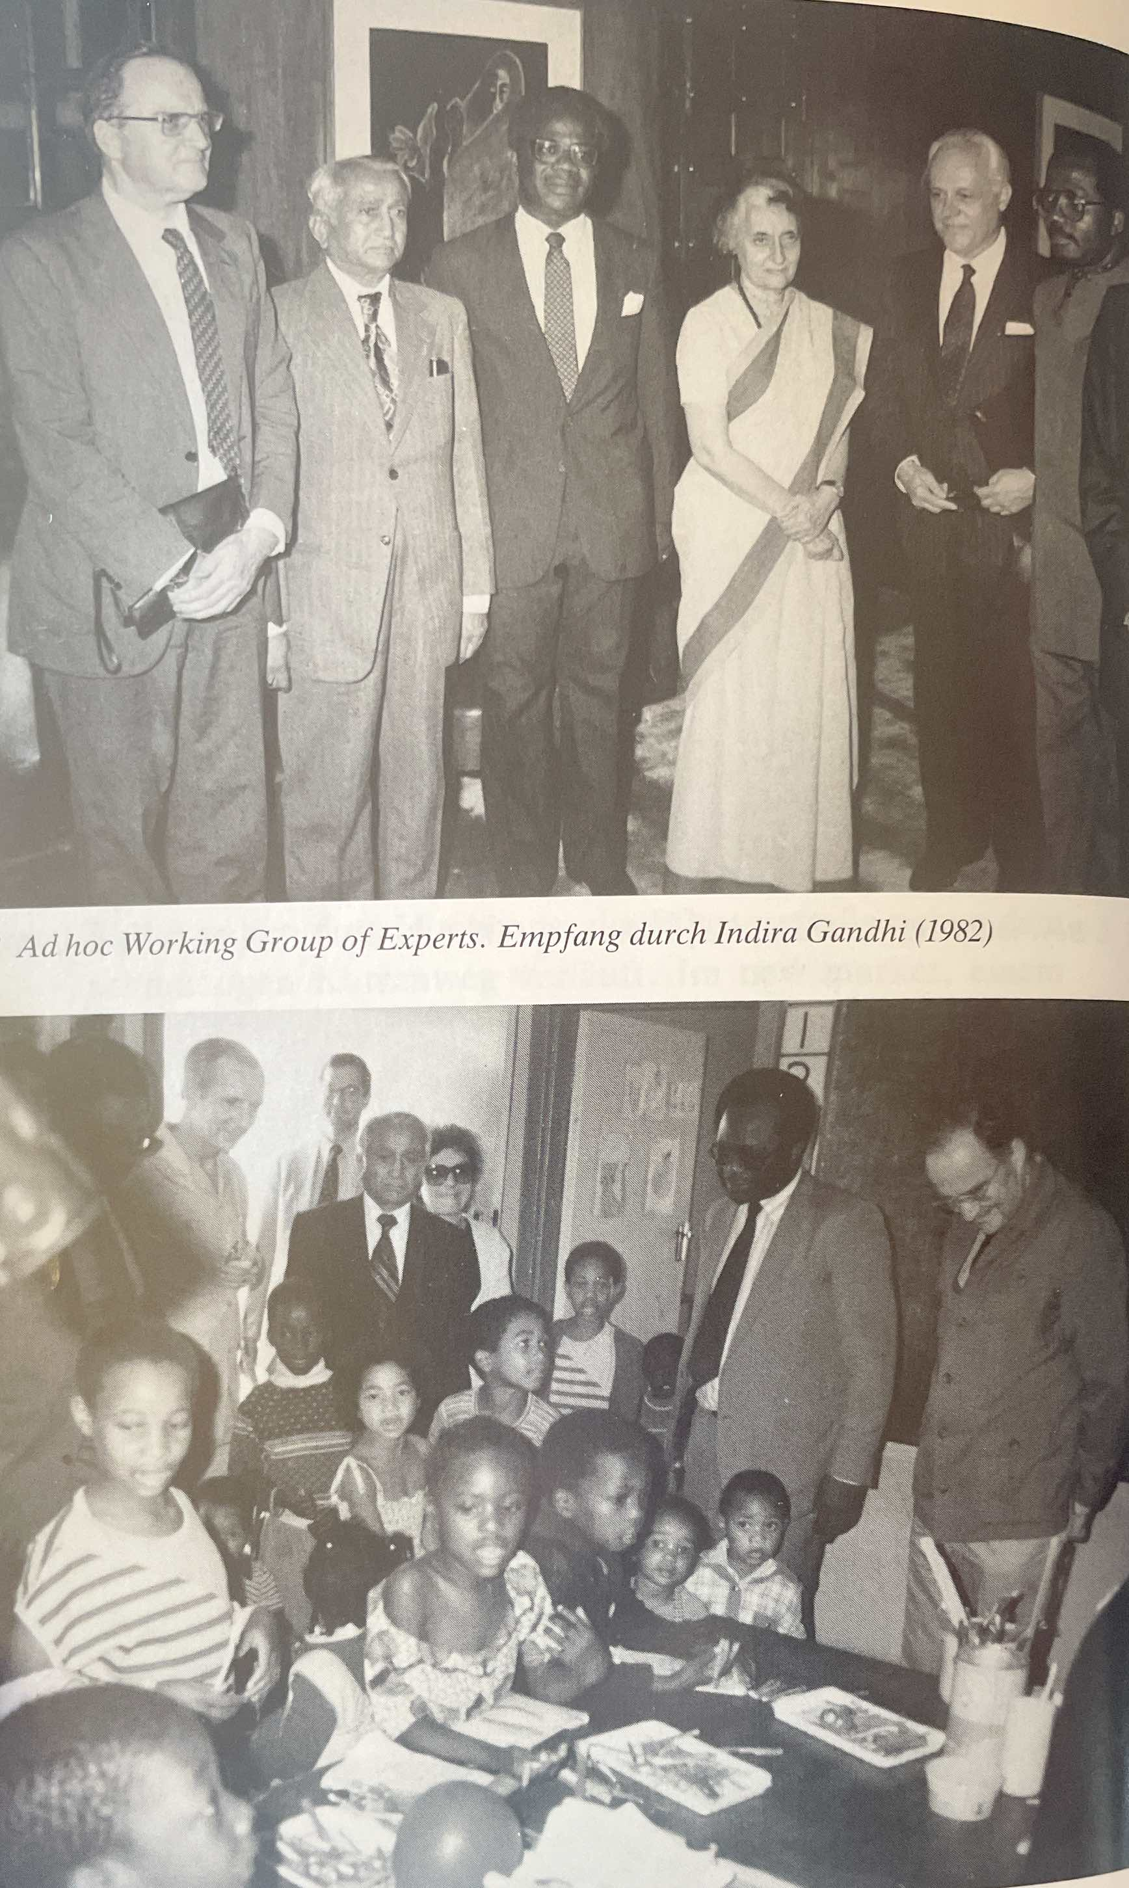

Slide 6
